Slide 1
OpenShift Container Platform 4
Emre Özkan
Solution Architect

Slide 2
Agenda
OpenShift and Kubernetes Core Concepts
OpenShift 4 Architecture
OpenShift Virtualization
OpenShift Security
OpenShift Developer Services

Slide 3
OpenShift and Kubernetes core concepts

Slide 4
VIRTUAL MACHINES AND CONTAINERS
Virtual Machine
Container
Application
Application
OS dependencies
OS dependencies
Operating System
Container Host
VM Isolation
Complete OS
Static Compute
Static Memory
High Resource Usage
Container Isolation
Shared Kernel
Burstable Compute
Burstable Memory
Low Resource Usage
Notes:
Although possible to run every application on a single virtual machine, the operational overhead and resource cost of the multitude of extra VMs required generally invalidates the perceived benefits
Virtual machines have the advantage of providing hypervisor-level isolation for the application. However that comes at the cost of running a complete operating system for each application which consumes more memory and cpu. Furthermore, VMs compute and memory capacity is pre-defined and do not provide any elasticity or bursting more when an application requires more memory or computing power.
Containers provide isolation through taking advantage of kernel technologies like cgroups, kernel namespaces and SELinux which have been battle-tested and used for years at Google and US Department of Defense to provide application isolation
Since containers use a shared kernel and container host, they reduce the amount of resources required for the container itself and are more lightweight than virtual machines. Therefore, containers provide an unmatched agility that is not feasible with virtual machines for example it only takes a few seconds to start a new container. Furthermore, containers support a more flexible model when it comes to compute and memory resources and allow resource burst modes so that applications can consume more resources when required within the defined boundaries.

Slide 5
OpenShift Concepts
a container is the smallest compute unit
CONTAINER

Slide 6
OpenShift Concepts
containers are created from container images
IMAGE
CONTAINER
BINARY
RUNTIME

Slide 7
OpenShift Concepts
container images are stored in an image registry
IMAGE REGISTRY
IMAGE
IMAGE
IMAGE
CONTAINER
IMAGE
IMAGE
IMAGE

Slide 8
OpenShift Concepts
an image repository contains all versions of an image in the image registry
IMAGE REGISTRY
myregistry/frontend
myregistry/mongo
frontend:latest
frontend:2.0
frontend:1.1
frontend:1.0
mongo:latest
mongo:3.7
mongo:3.6
mongo:3.4
IMAGE
IMAGE
IMAGE
IMAGE
IMAGE
IMAGE
IMAGE
IMAGE

Slide 9
OpenShift Concepts
containers are wrapped in pods which are units of deployment and management
POD
POD
CONTAINER
CONTAINER
CONTAINER
10.140.4.44
10.15.6.55

Slide 10
OpenShift Concepts
ReplicationControllers & ReplicaSets ensure a specified number of pods are running at any given time
1
2
N
image name
replicas
labels cpu memory
storage
POD
POD
POD
...
CONTAINER
CONTAINER
CONTAINER
ReplicaSet ReplicationController

Slide 11
OpenShift Concepts
Deployments and DeploymentConfigurations define how to roll out new versions of Pods
v1
v2
image name
replicas
labels
version
strategy
POD
POD
CONTAINER
CONTAINER
Deployment DeploymentConfig

Slide 12
OpenShift Concepts
a daemonset ensures that all (or some) nodes run a copy of a pod
✓
✓
image name
replicas
labels cpu memory
storage
POD
POD
CONTAINER
CONTAINER
DaemonSet
Node
Node
Node
foo = bar
foo = bar
foo = baz

Slide 13
OpenShift Concepts
configmaps allow you to decouple configuration artifacts from image content
Dev
Prod
appconfig.conf
MYCONFIG=true
POD
appconfig.conf MYCONFIG=false
POD
CONTAINER
CONTAINER
ConfigMap
ConfigMap

Slide 14
OpenShift Concepts
secrets provide a mechanism to hold sensitive information such as passwords
Dev
Prod
hash.pw
ZGV2Cg==
POD
hash.pw cHJvZAo=
POD
CONTAINER
CONTAINER
ConfigMap
ConfigMap
Notes:
Secure mechanism for holding sensitive data e.g.
Passwords and credentials
SSH Keys
Certificates
Secrets are made available as
Environment variables
Volume mounts
Interaction with external systems
Encrypted in transit and at rest
Having an easy-to-use, secure-by-default secret distribution mechanism is exactly what developers and ops need to solve the secrets management problem once and for all
Because secret objects can be created independently of the pods that use them, there is less risk of the secret being exposed during the workflow of creating, viewing, and editing pods.
A secret is only sent to a node if a pod on that node requires it. It is not written to disk. It is stored in a temporary file-storage facilities (tmpfs). It is deleted once the pod that depends on it is deleted.
Secrets are stored as plaintext in etcd however the etcd storage can be encrypted to remove the security risk

Slide 15
OPENSHIFT & KUBERNETES CONCEPTS
services provide internal load-balancing and service discovery across pods
SERVICE
“backend”
role: backend
POD
POD
POD
POD
role: frontend
CONTAINER
role: backend
CONTAINER
role: backend
CONTAINER
role: backend
CONTAINER
10.140.4.44
10.110.1.11
10.120.2.22
10.130.3.33

Slide 16
OPENSHIFT & KUBERNETES CONCEPTS
apps can talk to each other via services
SERVICE
“backend”
role: backend
POD
POD
POD
POD
role: frontend
CONTAINER
role: backend
CONTAINER
role: backend
CONTAINER
role: backend
CONTAINER
10.140.4.44
10.110.1.11
10.120.2.22
10.130.3.33

Slide 17
OpenShift Concepts
routes make services accessible to clients outside the environment via real-world urls
app-prod.mycompany.com
ROUTE
SERVICE
“frontend”
> curl http://app-prod.mycompany.com
role: frontend
POD
POD
POD
role: frontend
CONTAINER
role: frontend
CONTAINER
role: frontend
CONTAINER
Notes:
A route exposes a service at a host name, like www.example.com, so that external clients can reach it by name.
DNS resolution for a host name is handled separately from routing. Admin may have configured a DNS wildcard entry that will resolve to the node that is running the OpenShift Container Platform router
Pods running on OpenShift, don’t need to go through the routing layer and can interact with each other directly through the services.
After the router discovers the Pod endpoints via the service, it sends the Pod traffic directly to those endpoints and bypasses the service layer

Slide 18



OpenShift Concepts
Persistent Volume and Claims
POD
2Gi
2Gi
CONTAINER
PersistentVolumeClaim
PersistentVolume
My app is stateful.
Notes:
OpenShift and Kubernetes can handle stateful applications that require storage, too. Users create claims for storage, and OpenShift connects those claims to real storage volumes. When applications are deployed, OpenShift automatically connects the real storage into the container as specified by the end user. And, as applications move around in the cluster, the storage automatically follows them. Many different storage types are supported, from raw to block to file, both read-write-once and read-write-many.

Slide 19

OpenShift Concepts
projects isolate apps across environments, teams, groups and departments
PAYMENT DEV
CATALOG
POD
POD
POD
❌
POD
POD
POD
C
C
C
C
C
C
PAYMENT PROD
INVENTORY
POD
POD
POD
❌
❌
POD
POD
POD
C
C
C
C
C
C

Slide 20
Three Types: One Goal
Application Probes
httpGet
POD
CONTAINER
exec
tcpSocket
Notes:
There are three types of application probes - httpGet, tcpSocket, and exec. They are all slightly different in how they probe the pods and containers
The httpGet probe makes a simple HTTP(S) connection. If the response code is between 200 and 399, the check is deemed successful.
The tcpSocket probe makes a pure socket connection to the identified port, and is only considered successful if the connection can complete.
Neither httpGet nor tcpSocket require anything special of the pods or containers being probed.
The most powerful probe is exec. This probe actually results in the specified executable being run inside the designated pod’s container(s). If the exit code of the executable is zero, the probe is considered successful. The reason that this probe is so powerful is that any executable inside the specified container may be run. This could be a custom program that checks not only the process running in the specified container, but that checks other things in or even outside of the OpenShift environment to determine whether to a pass or fail is warranted.

Slide 21




Liveness Probes
Application Probes
alive?
Notes:
The liveness probe determines whether or not a pod is alive and healthy. If a liveness probe fails, OpenShift will terminate the pod and then restart it with an exponential back-off delay.

Slide 22


Readiness Probes
Application Probes
SERVICE
ready?
POD
POD
POD
Notes:
Readiness probes determine if a pod is able to receive traffic. It is possible that certain application instances may not be dead or require restart, but may also not be in a state where additional traffic should be sent to them. As an example, an application that has hit its CPU threshold or for some other reason cannot handle additional load may still be working fine, but sending new load to it may cause service disruptions.
If a readiness probe fails a sufficient number of times, the pod is marked as not ready, and this causes it to be removed from any endpoint lists for services that would map to it. In this way, additional traffic going to the service is no longer balanced across pods that are not ready. Once the pod passes readiness checks again, it is marked ready, and this results in the pod being re-added to the endpoint lists. Then, traffic will again be distributed to the pod.

Slide 23
OpenShift 4 Architecture

Slide 24
your choice of infrastructure
OPENSHIFT CONTAINER PLATFORM | Architectural Overview
COMPUTE
NETWORK
STORAGE
Notes:
OpenShift runs on a variety of infrastructure platforms, from bare metal to private cloud to public cloud.

Slide 25
workers run workloads
OPENSHIFT CONTAINER PLATFORM | Architectural Overview
WORKER
WORKER
COMPUTE
NETWORK
STORAGE
Notes:
There are two types of hosts in an OpenShift environment. Workers are where user workload and various OpenShift components will land. Workers can be easily scaled and, on cloud providers, even scaled automatically based on cluster capacity.

Slide 26
masters are the control plane
OPENSHIFT CONTAINER PLATFORM | Architectural Overview
MASTER
COMPUTE
NETWORK
STORAGE
Notes:
The other type of host is the master. OpenShift uses 3 masters for high availability and cluster quorum. User workload does not run on the masters.

Slide 27
everything runs in pods
OPENSHIFT CONTAINER PLATFORM | Architectural Overview
POD
IMAGE
CONTAINER
CONTAINER
10.140.4.44
Notes:
The pod is the deployable and scheduleable unit in an OpenShift environment. While a pod may have more than one container, all containers in the pod share a single network namespace, and the pod receives a single IP address on the software defined network inside the cluster.

Slide 28

state of everything
OPENSHIFT CONTAINER PLATFORM | Architectural Overview
MASTER
etcd
COMPUTE
NETWORK
STORAGE
Notes:
etcd is used to keep track of the state of everything in the cluster, from which users are logged in to where workload lives and more.

Slide 29
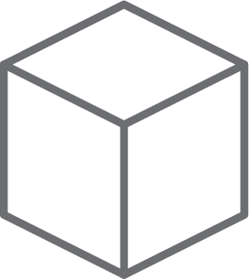
core kubernetes components
OPENSHIFT CONTAINER PLATFORM | Architectural Overview
MASTER
Kubernetes
API server
Kubernetes
services
Scheduler
etcd
Cluster Management
COMPUTE
NETWORK
STORAGE
Notes:
OpenShift is built on Kubernetes, and its core components are still there and directly accessible via Kubernetes’ APIs.

Slide 30

core OpenShift components
OPENSHIFT CONTAINER PLATFORM | Architectural Overview
MASTER
OpenShift
services
OpenShift
API server
Kubernetes
services
Operator Lifecycle Management
etcd
Web Console
COMPUTE
NETWORK
STORAGE
Notes:
OpenShift brings its own web console with special features for both administrators and developers. OpenShift makes its features available through its own API endpoints which follow the same standard as other Kubernetes APIs using Custom Resource Definitions. OpenShift also brings a full lifecycle management solution that’s deeply integrated which allows for seamless and automatic cluster upgrades from within the cluster itself.

Slide 31
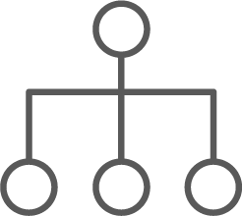
internal and support infrastructure services
OPENSHIFT CONTAINER PLATFORM | Architectural Overview
MASTER
OpenShift Services
Infrastructure
services
Monitoring | Logging | Tuned | SDN | DNS | Kubelet
Kubernetes
services
etcd
COMPUTE
NETWORK
STORAGE
Notes:
OpenShift includes a number of internal and support infrastructure services that make containers easier to use at scale.

Slide 32

run on all hosts
OPENSHIFT CONTAINER PLATFORM | Architectural Overview
MASTER
WORKER
WORKER
OpenShift Services
Infrastructure
services
Kubernetes
services
etcd
Monitoring | Logging | Tuned SDN | DNS | Kubelet
Monitoring | Logging | Tuned SDN | DNS | Kubelet
COMPUTE
NETWORK
STORAGE
Notes:
And, because these services all run in pods as part of the platform, they can be orchestrated like any other workload and made to run across all hosts in the environment.

Slide 33
integrated image registry
OPENSHIFT CONTAINER PLATFORM | Architectural Overview
MASTER
WORKER
WORKER
OpenShift Services
Infrastructure
services
Registry
Registry
Kubernetes
services
etcd
Monitoring | Logging | Tuned SDN | DNS | Kubelet
Monitoring | Logging | Tuned SDN | DNS | Kubelet
COMPUTE
NETWORK
STORAGE
Notes:
OpenShift includes an integrated container image registry. This registry is tied into OpenShift’s own role-based access control, providing multi-tenancy benefits. Images that are built inside the platform using OpenShift’s native build features automatically land in this image registry. Being a fully OCI-compliant registry, images created outside of the environment can also be placed into the integrated registry as part of a larger software devleopment lifecycle (SDLC) process.

Slide 34
cluster monitoring
OPENSHIFT CONTAINER PLATFORM | Architectural Overview
MASTER
WORKER
WORKER
OpenShift Services
Infrastructure
services
Registry
Registry
Kubernetes
services
Prometheus | Grafana Alertmanager
Prometheus | Grafana Alertmanager
etcd
Monitoring | Logging | Tuned SDN | DNS | Kubelet
Monitoring | Logging | Tuned SDN | DNS | Kubelet
COMPUTE
NETWORK
STORAGE
Notes:
OpenShift includes a cluster monitoring solution informed by the best practices of Red Hat’s own site reliability engineers (SREs). This preconfigured stack, based on Prometheus, Grafana, and Alertmanager helps platform administrators understand the health and capacity of the OpenShift cluster.

Slide 35
log aggregation
OPENSHIFT CONTAINER PLATFORM | Architectural Overview
MASTER
WORKER
WORKER
OpenShift Services
Kibana | Elasticsearch
Kibana | Elasticsearch
Infrastructure
services
Registry
Registry
Kubernetes
services
Prometheus | Grafana Alertmanager
Prometheus | Grafana Alertmanager
etcd
Monitoring | Logging | Tuned SDN | DNS | Kubelet
Monitoring | Logging | Tuned SDN | DNS | Kubelet
COMPUTE
NETWORK
STORAGE
Notes:
OpenShift also includes a log aggregation solution based on Fluentd, Elasticsearch, and Kibana. This integrated solution makes it easy to visualize and corroborate log events for applications that are scaled to many instances, and, it, too, is tied into OpenShift’s role-based access control (RBAC) ensuring that only the right people see the logs they are supposed to.

Slide 36
integrated routing
OPENSHIFT CONTAINER PLATFORM | Architectural Overview
MASTER
WORKER
WORKER
OpenShift Services
Kibana | Elasticsearch
Kibana | Elasticsearch
Infrastructure
services
Registry
Registry
Kubernetes
services
Router
Router
Prometheus | Grafana Alertmanager
Prometheus | Grafana Alertmanager
etcd
Monitoring | Logging | Tuned SDN | DNS | Kubelet
Monitoring | Logging | Tuned SDN | DNS | Kubelet
COMPUTE
NETWORK
STORAGE
Notes:
OpenShift extends Kubernetes ingress capabilities with an integrated router that bridges traffic from outside the cluster into the software defined network (SDN). This routing solution makes it easy for workload to be exposed and made accessible to consumers that are not inside the cluster.

Slide 37
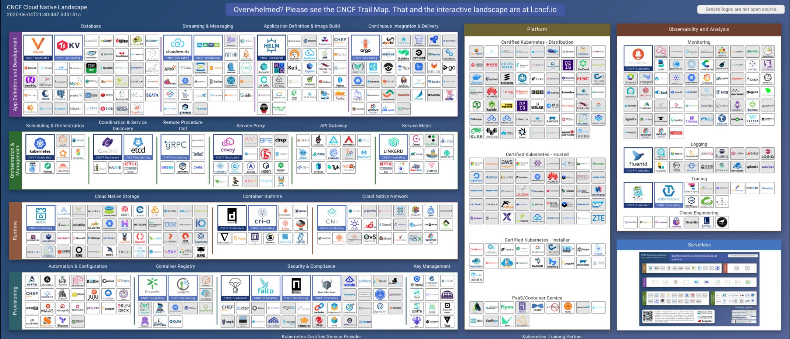
The Cloud Native App Dev Challenge
Notes:
THIS IS A MAP OF ALL THE CLOUD-NATIVE COMPONENTS YOU NEED TO CHOOSE FROM IN ORDER TO RUN CONTAINERS IN PRODUCTION. It’s compiled by the Cloud Native Computing Foundation, the same open source governing body that is home to Kubernetes (which was its first project). It covers everything from infrastructure through application / developer services, as well as observability tools for the whole stack. It gets bigger and more complicated every few weeks, when a new revision rolls out. (Side note: this does not include serverless frameworks - that’s an entirely separate map)
Latest version of this map is always here: https://github.com/cncf/landscape

Slide 38
OPENSHIFT CONTAINER PLATFORM | Functional Overview
Value of OpenShift
Monitoring, Logging, Registry, Router, Telemetry
Service Mesh, Serverless, Middleware/Runtimes, ISVs
Dev Tools, CI/CD, Automated Builds, IDE
Cluster Services
Application Services
Developer Services
Automated Operations
Kubernetes
Red Hat Enterprise Linux | RHEL CoreOS
Best IT Ops Experience
CaaS
PaaS
FaaS
Best Developer Experience

Slide 39




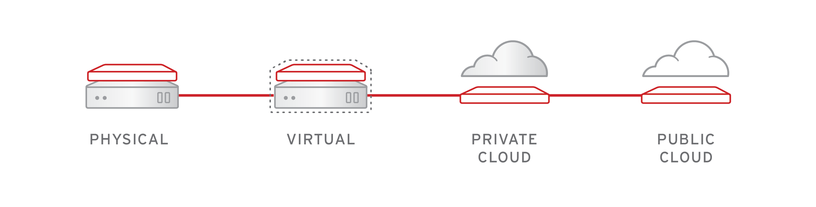
FULL STACK AUTOMATED INSTALL
OPENSHIFT 3
OPENSHIFT 4
OPENSHIFT PLATFORM
OPENSHIFT PLATFORM
OPERATING SYSTEM
OPERATING SYSTEM
INFRASTRUCTURE
Notes:
This diagram shows how we are bringing full stack install automation on immutable infrastructure to OpenShift 4
On the left, you see how OpenShift 3 installer works. To install OpenShift 3, a user must first configure the underlying infrastructure provider, then deploy RHEL installs, then they can install OpenShift on top of that. From there, OpenShift and RHEL are upgraded and managed separately but must remain in synch.
On the right, you see how OpenShift 4 installer works. The OpenShift 4 includes RHEL CoreOS as a component of the product. OpenShift 4 install will first configure the underlying provider, then spin up RHEL CoreOS Nodes, then deploy your Kubernetes cluster and cluster services on it.
You go from configuring and managing 3 separate entities, to one full stack automated installation process.

Slide 40
INSTALLER PROVISIONED INFRASTRUCTURE (IPI)
Day 1: OpenShift install - Day 2: Operators
User managed
Control Plane
Worker Nodes
Installer/Operator managed
Red Hat OpenShift Container Platform cluster services
Red Hat OpenShift Container Platform cluster
openshift-install
Red Hat Enterprise Linux CoreOS
Red Hat Enterprise Linux CoreOS
Cloud resources
Cloud resources
Notes:
Customers aren’t just struggling to install OpenShift, they also struggle with upgrades and staying up to date with the latest patch and feature releases
Our goal is not just to simplify OpenShift installation, but to make upgrades seamless through a new fully automated, over the air update model.
We want to make upgrading the OpenShift platform as easy as updating your mobile phone platform

Slide 41
USER PROVISIONED INFRASTRUCTURE (UPI)
Day 1: OpenShift install - Day 2: Operators + Customer Managed Nodes & Infra
User managed
Control Plane
Worker Nodes
Installer/Operator managed
Red Hat OpenShift Container Platform cluster services
openshift-install
Red Hat OpenShift Container Platform cluster
Red Hat Enterprise Linux CoreOS
Red Hat Enterprise Linux /
RHEL CoreOS
Customer deployed
Cloud resources
Cloud resources
Notes:
Customers aren’t just struggling to install OpenShift, they also struggle with upgrades and staying up to date with the latest patch and feature releases
Our goal is not just to simplify OpenShift installation, but to make upgrades seamless through a new fully automated, over the air update model.
We want to make upgrading the OpenShift platform as easy as updating your mobile phone platform

Slide 42

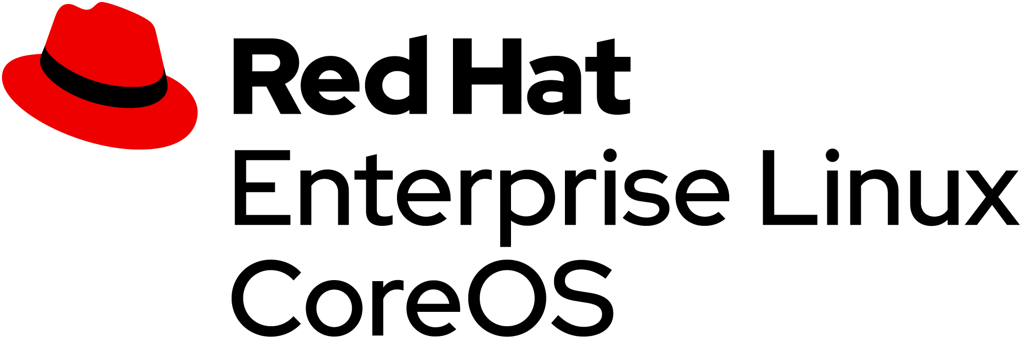

Red Hat Enterprise Linux CoreOS
Minimal Linux distribution
Optimized for running containers
Decreased attack surface
Over-the-air automated updates
Immutable foundation for OpenShift clusters
Ignition-based Metal and Cloud host configuration
Notes:
Customers aren’t just struggling to install OpenShift, they also struggle with upgrades and staying up to date with the latest patch and feature releases
Our goal is not just to simplify OpenShift installation, but to make upgrades seamless through a new fully automated, over the air update model.
We want to make upgrading the OpenShift platform as easy as updating your mobile phone platform

Slide 43



OPENSHIFT PLATFORM
Immutable Operating System
Red Hat Enterprise Linux CoreOS is versioned with OpenShift
CoreOS is tested and shipped in conjunction with the platform. Red Hat runs thousands of tests against these configurations.
Red Hat Enterprise Linux CoreOS is managed by the cluster
The Operating system is operated as part of the cluster, with the config for components managed by Machine Config Operator:
CRI-O config
Kubelet config
Authorized registries
SSH config
RHEL CoreOS admins are responsible for:
Nothing.
v4.1.6
v4.1.6

Slide 44

OpenShift Architecture
A lightweight, OCI-compliant container runtime
Minimal and Secure Architecture
Optimized for Kubernetes
Runs any OCI-compliant image (including docker)

Slide 45
CoreOS “pod” architecture
kubelet static containers
scheduled containers
etcd
kube controller-manager
coredns
openshift controller-manager
systemd-managed native binaries
kubelet
CRI-O
kube-scheduler
kube-apiserver
openshift-apiserver
openshift-oauth
Notes:
CoreOS is a container-optimized appliance-like operating system designed explicitly as a component of OpenShift where everything runs as a container. However, not everything runs as an _orchestrated_ container scheduled by Kubernetes.
Here we show the nature of “static” versus “scheduled” or “dynamic” pods on a CoreOS host. In this case we are focusing on one of the master hosts.

Slide 46
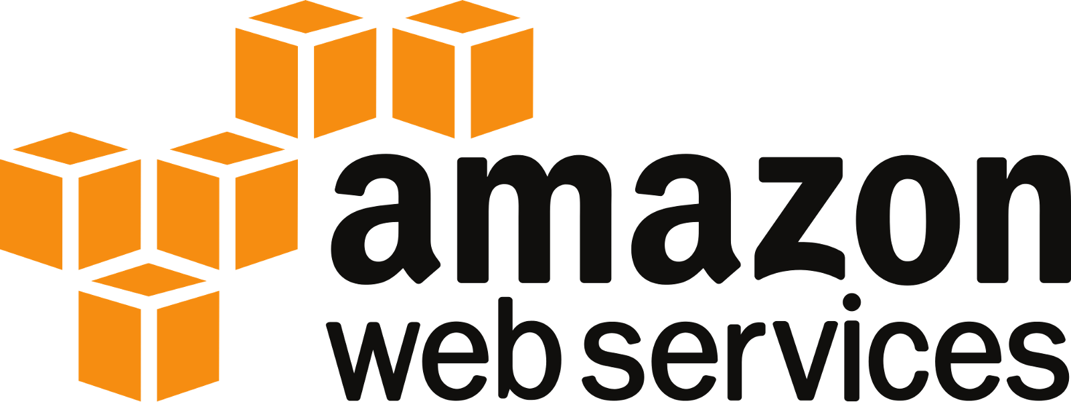




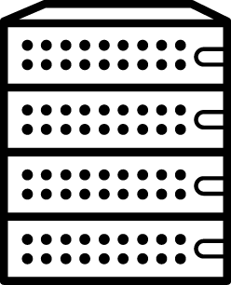



Supported Providers
Full Stack Automation (IPI)
Pre-existing Infrastructure (UPI)
Bare Metal
Bare Metal
IBM Power Systems
New addition in OCP 4.6
Now supports deploying to VMware vSphere 7.0
Generally Available
Product Manager(s): Katherine Dubé (AWS, Azure, GCP), Maria Bracho (VMware), Peter Lauterbach (RHV & OCP Virtualization), Ramon Acedo Rodriguez (OSP, BM), & Duncan Hardie (IBM Z & Power)
Notes:
For OpenShift 4, there’s two primary installation experiences:
Full Stack Automation, where the installer controls all areas of the installation including infrastructure provisioning with an opinionated “best practices” deployment of OpenShift.
Pre-existing infrastructure deployments, where administrators are responsible for creating and managing their own infrastructure allowing greater customization and operational flexibility.
For 4.6, the supported provider list largely stays the same as 4.5 with the exception of extending Bare Metal support for installer provisioned infrastructure, new Government region support for AWS & Azure, and support for deploying to VMware vSphere 7.0 in addition to 6.5 & 6.7.

Slide 47




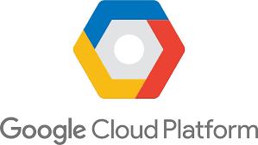
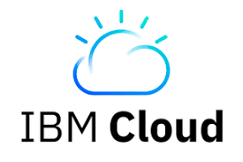
OpenShift offers the broadest set of hybrid cloud services
On-premises
OpenShift Dedicated
Managed By Red Hat
or
Amazon Red Hat OpenShift
Managed by Red Hat & AWS
or
Customer
Managed
or
Customer Managed
Red Hat OpenShift Dedicated
Managed By Red Hat
or
Customer
Managed
Red Hat OpenShift on IBM Cloud
or
Customer
Managed (UPI)
Customer Managed
Azure Red Hat OpenShift
Jointly Managed & Supported
Jointly Engineered
Notes:
Speaker: Patrick Strick
OpenShift is a single product with multiple consumption models to give a choice to customers in order to balance their productivity and operational efforts versus the level control they need over the platform.
OpenShift Dedicated: a professionally managed, enterprise-grade Kubernetes by Red Hat on Amazon Web Services and Google Cloud Platform
Azure Red Hat OpenShift: Jointly engineered, operated, and supported by both Microsoft and Red Hat with an integrated support experience
Red Hat OpenShift on IBM Cloud:
OpenShift Container Platform: secure Kubernetes platform on your own infrastructure. Build, deploy and manage your container-based applications consistently across cloud and on-premise infrastructure.

Slide 48
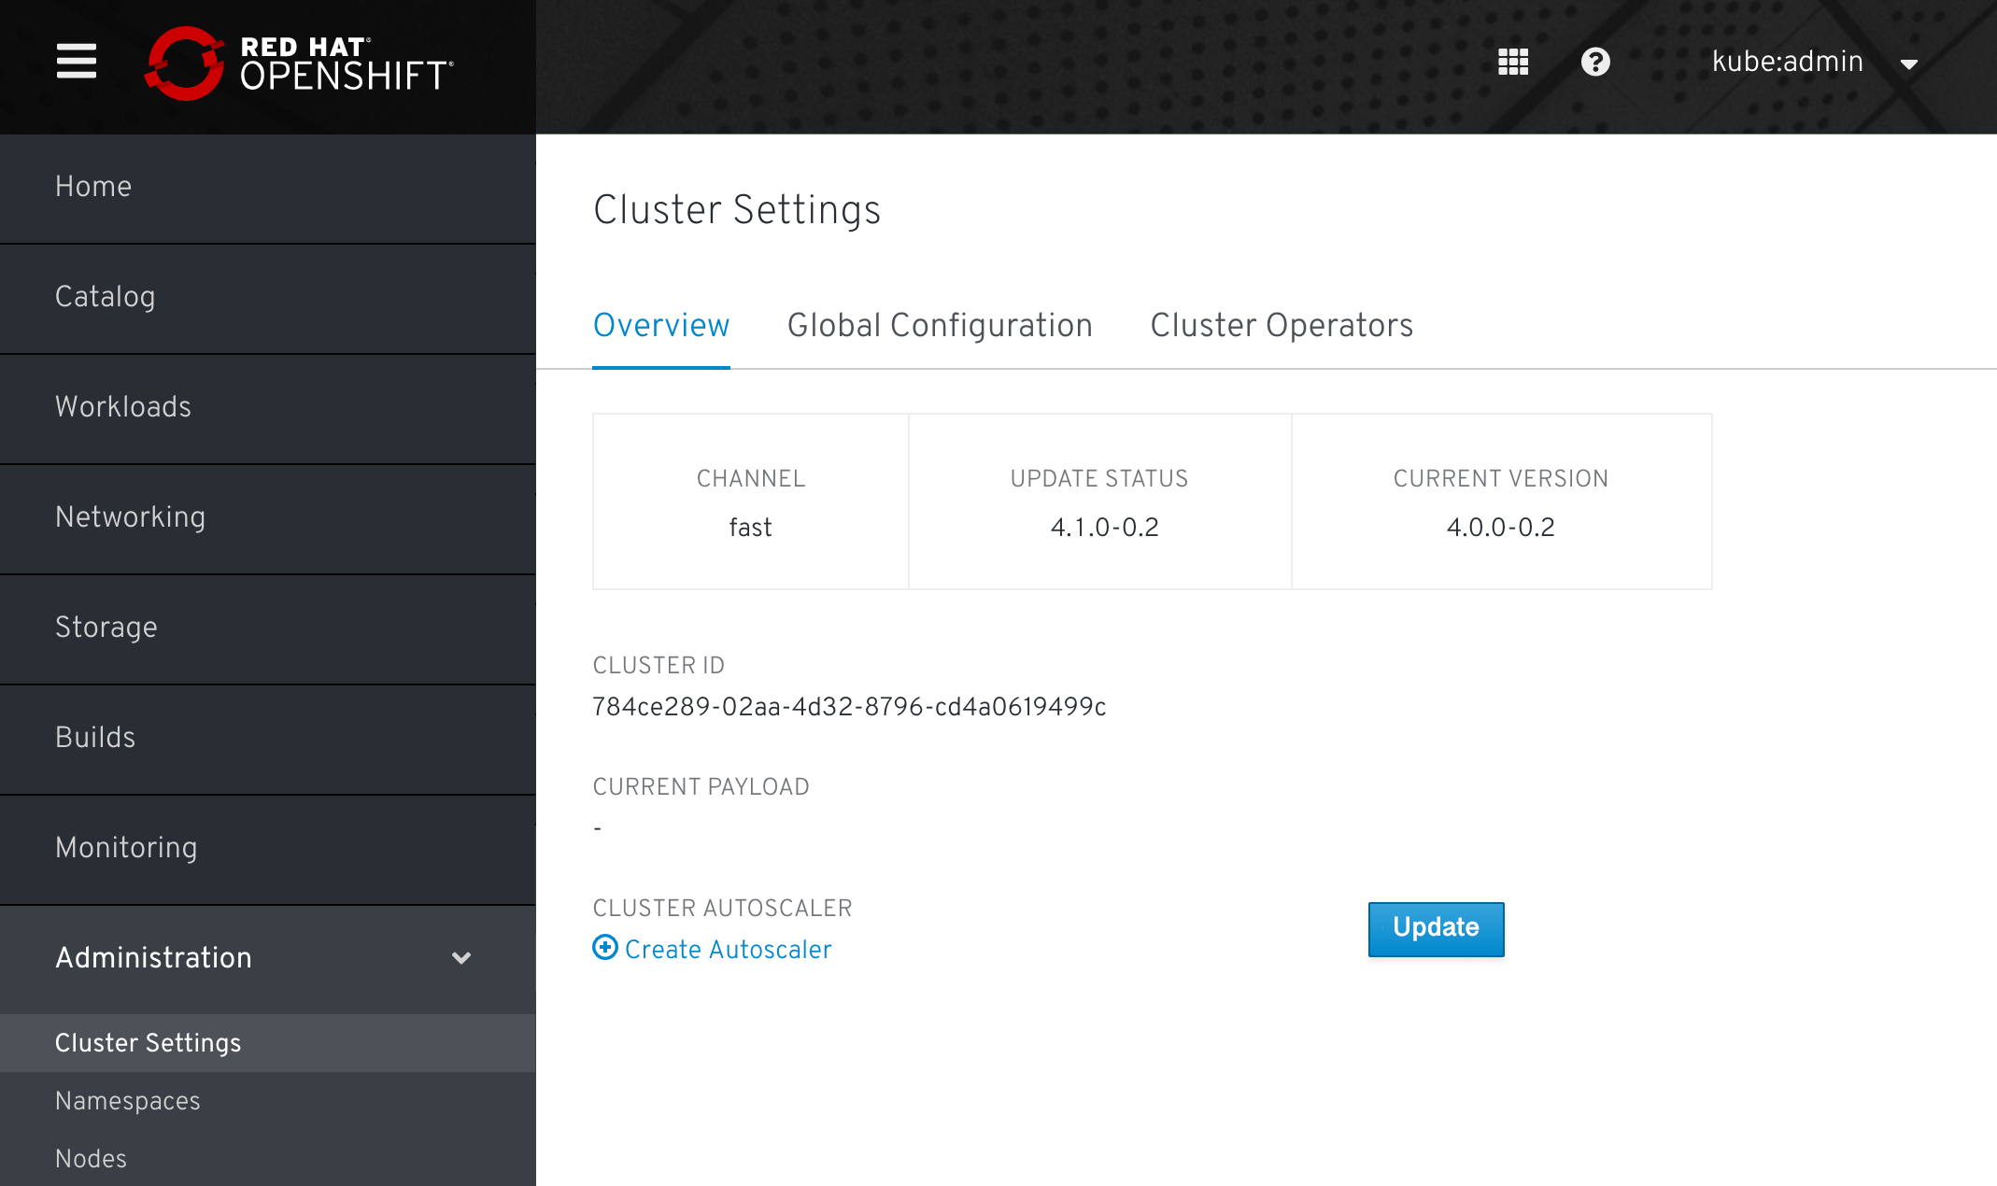
OVER-THE-AIR UPDATES
OpenShift retrieves list of available updates
Admin selects the target version
OpenShift is updated over the air
Auto-update support
Notes:
Customers aren’t just struggling to install OpenShift, they also struggle with upgrades and staying up to date with the latest patch and feature releases
Our goal is not just to simplify OpenShift installation, but to make upgrades seamless through a new fully automated, over the air update model.
We want to make upgrading the OpenShift platform as easy as updating your mobile phone platform

Slide 49

OPERATOR FRAMEWORK
Operators codify operational knowledge and workflows to automate life cycle management of containerized applications with Kubernetes
SDK
LIFE CYCLE MANAGEMENT
METERING
Notes:
The Operator Framework, which we launched last year, helps users automate the management of services that run on Kubernetes across multiple clouds
Operators are officially supported in OpenShift 4 and the OpenShift 4 installer includes more than 40 different operators, which manage the install and upgrades of various OpenShift cluster services
Operators have also been a big hit with ISV Partners and we are working with them to build operators and create a certified ISV partner ecosystem

Slide 50
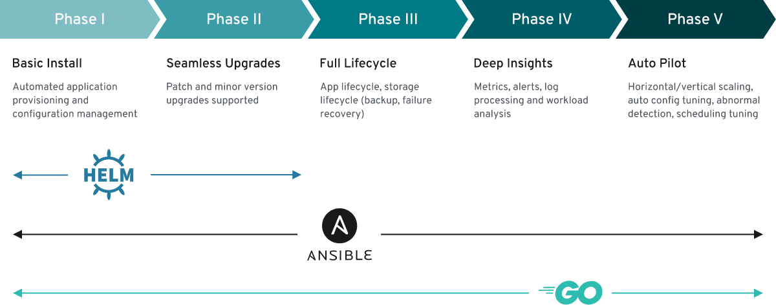
OPERATOR FRAMEWORK
Notes:
The Operator Framework, which we launched last year, helps users automate the management of services that run on Kubernetes across multiple clouds
Operators are officially supported in OpenShift 4 and the OpenShift 4 installer includes more than 40 different operators, which manage the install and upgrades of various OpenShift cluster services
Operators have also been a big hit with ISV Partners and we are working with them to build operators and create a certified ISV partner ecosystem

Slide 51
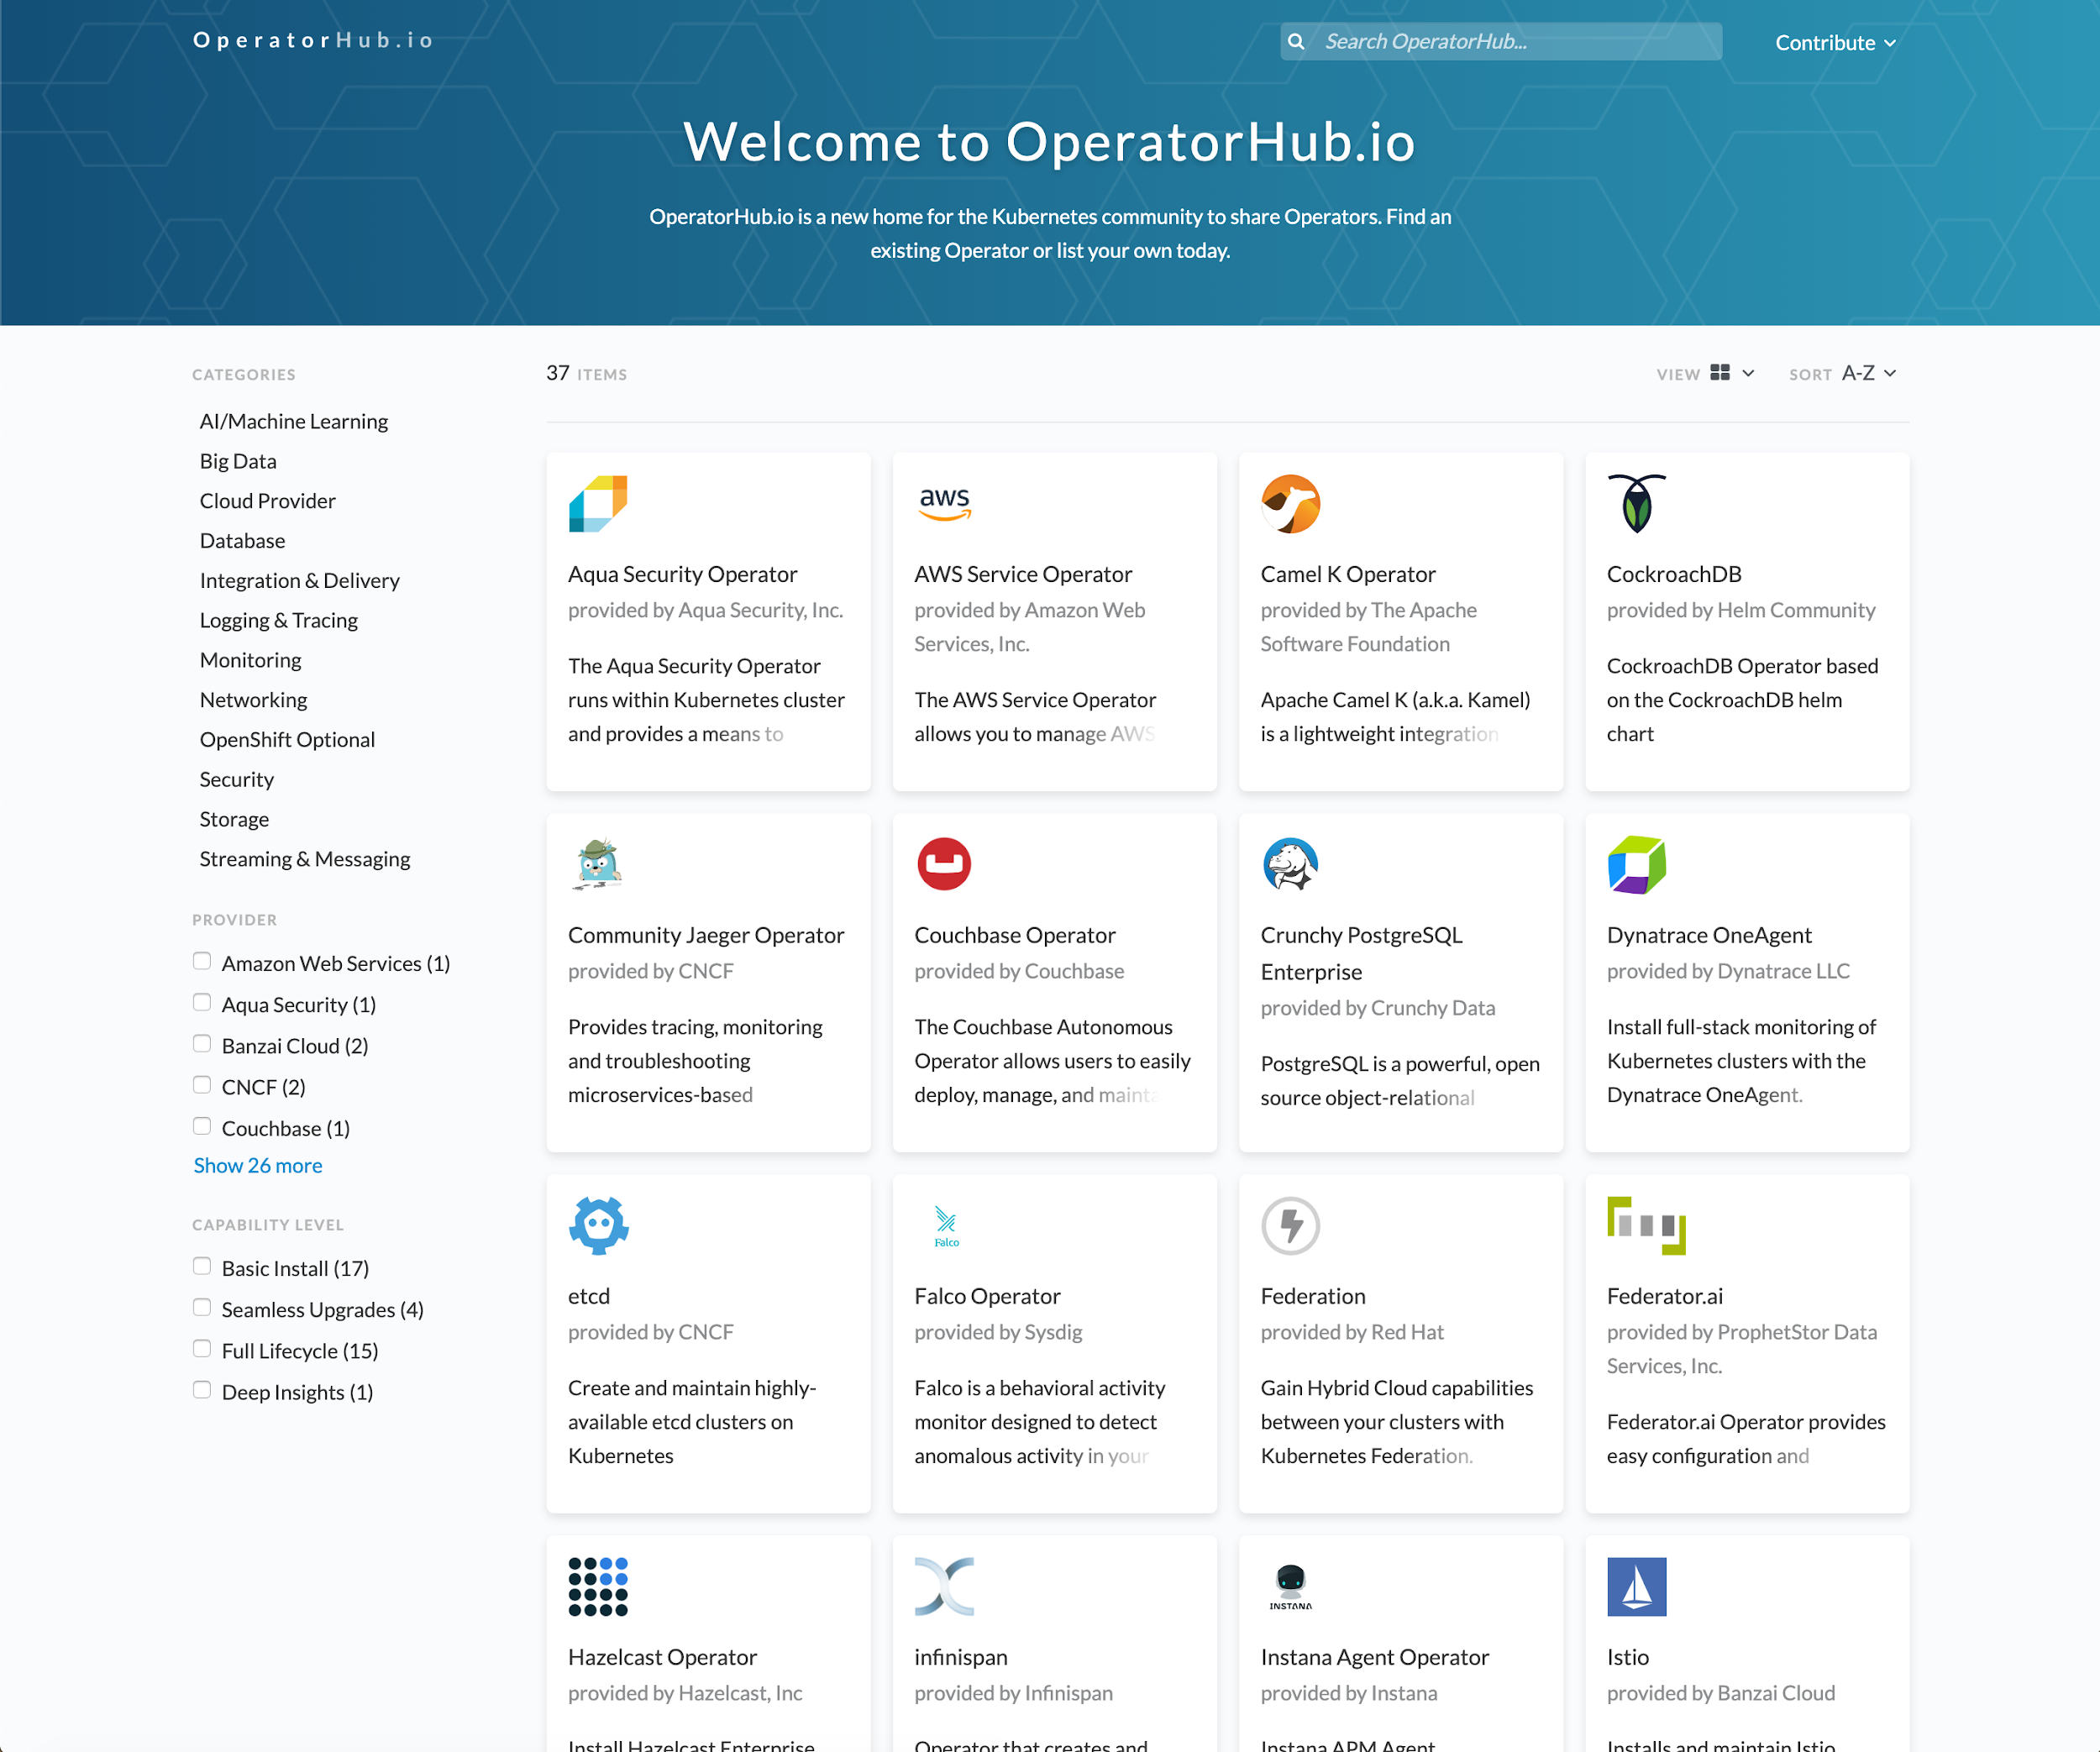
OperatorHub.io Ecosystem
The public registry for finding Kubernetes Operator backed services

Slide 52
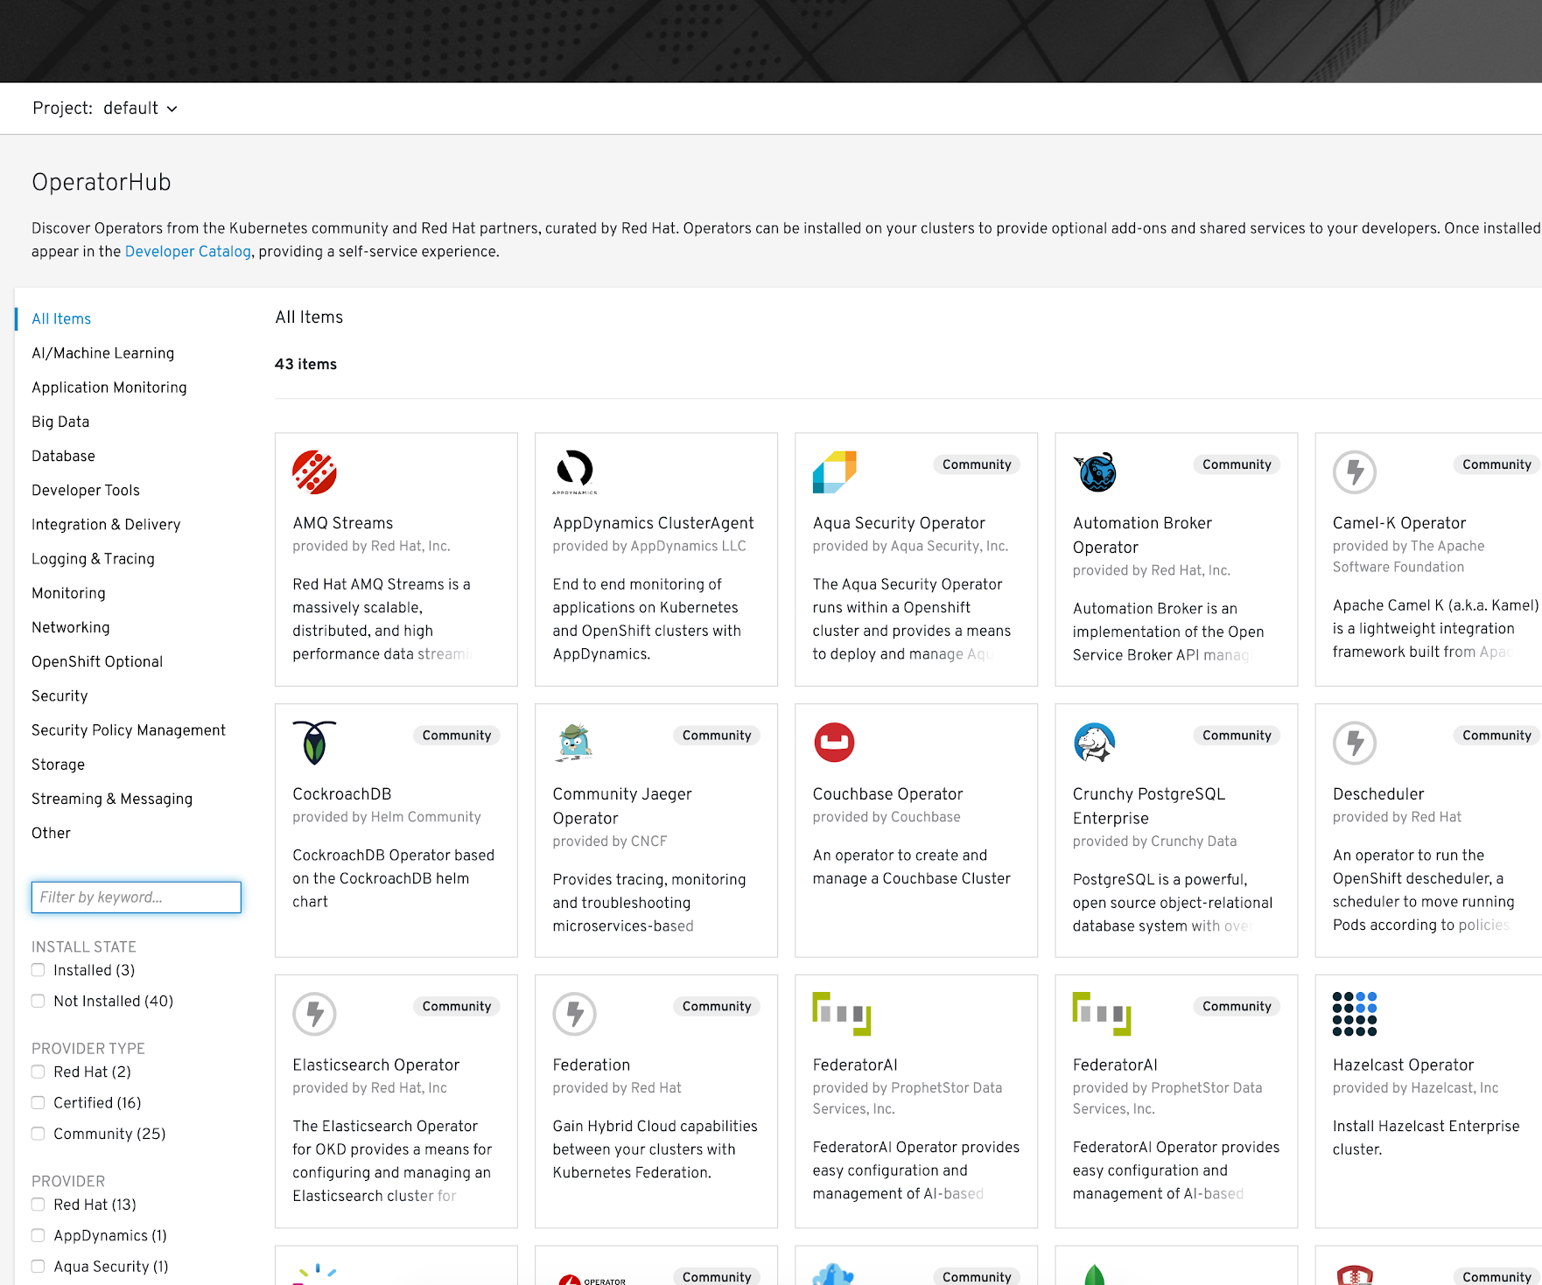
OperatorHub in OpenShift
The embedded registry for Community and Certified Operators from Red Hat and Partners, tested and verified on OpenShift 4

Slide 53
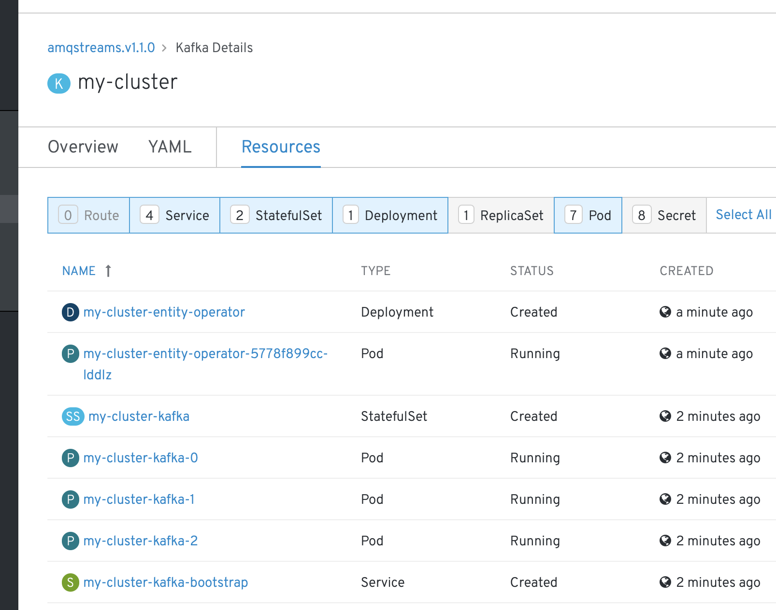
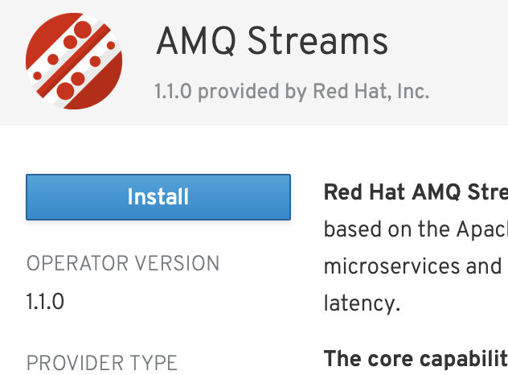
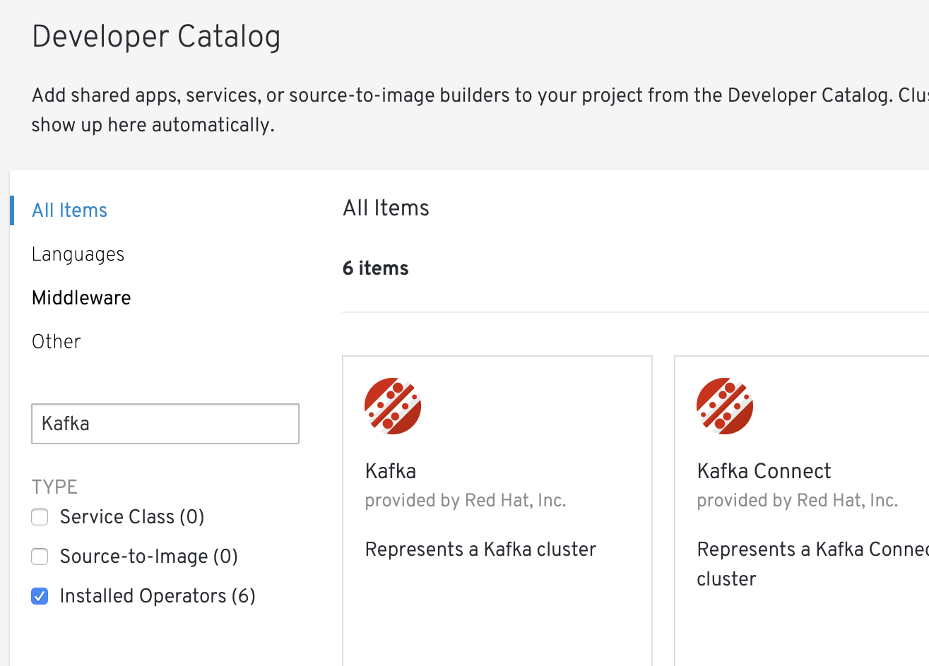
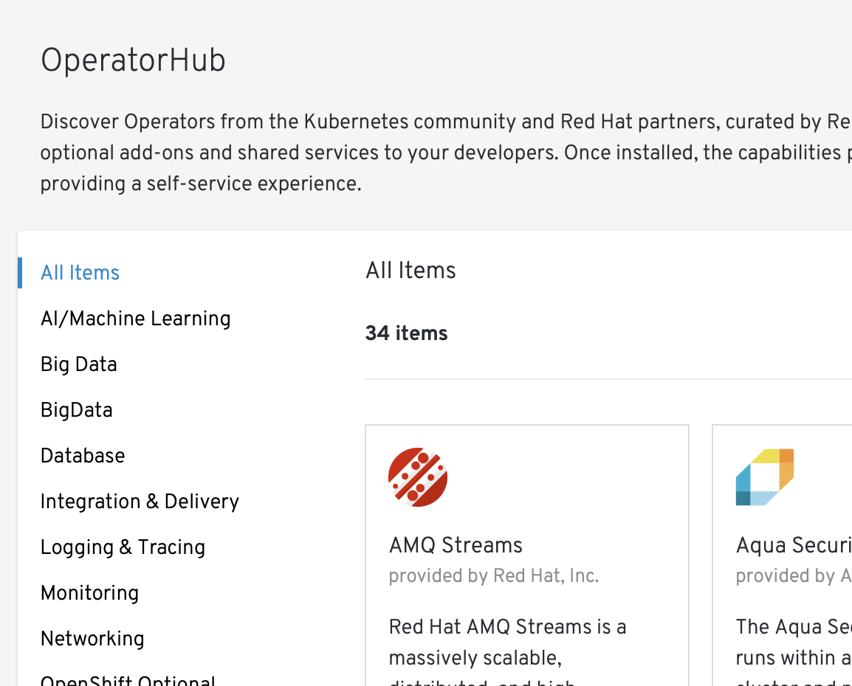
OperatorHub in OpenShift
For Cluster Admins:
For Developers:
Discovery/install/upgrade of Operators
Community, Red Hat products, Certified ISVs
Granular access via specific Projects
Developers can’t see admin screens
Operator capabilities are exposed in Catalog
Self-service management

Slide 54
Machine Config Operator A Kube-native way to configure hosts
OpenShift Cluster Management | Machine Configuration
# test.yaml apiVersion: machineconfiguration.openshift.io/v1 kind: MachineConfig metadata: labels: machineconfiguration.openshift.io/role: worker name: test-file spec: config: storage: files: - contents: source: data:,hello%20world%0A verification: {} filesystem: root mode: 420 path: /etc/test
OS configuration is stored and applied across the cluster via the Machine Config Operator.
Subset of ignition modules applicable post provisioning
SSH keys
Files
systemd units
kernel arguments
Standard k8s YAML/JSON manifests
Desired state of nodes is checked/fixed regularly
Can be paused to suspend operations
Notes:
The Machine Config Operator provides cluster-level configuration, enables rolling upgrades, and prevents drift between new and existing nodes. The MCO is the heart of what makes RHCOS a kube-native operating system.

Slide 55
OpenShift Virtualization

Slide 56

OpenShift Virtualization
A virtualization API and runtime for OpenShift, built on KubeVirt, to run and manage virtual machines using a Kubernetes-native way
Notes:
KubeVirt
is a CNCF Sandbox project which provides a -- Virtualization API and runtime for Kubernetes in order to run and manage virtual machines.
… natively on Kubernetes

Slide 57
OpenShift Virtualization
Virtual machines
Running in containers
Using the KVM hypervisor
Scheduled, deployed, and managed by Kubernetes
Integrated with container orchestrator resources and services
Traditional Pod-like SDN connectivity and/or connectivity to external VLAN and other networks via multus
Persistent storage paradigm (PVC, PV, StorageClass)

Slide 58


Virtual machines in a container world
Provides a way to transition application components which cannot be directly containerized into a Kubernetes system
Integrates directly into existing k8s clusters
Follows Kubernetes paradigms:
Container Networking Interface (CNI)
Container Storage Interface (CSI)
Custom Resource Definitions (CRD, CR)
Schedule, connect, and consume VM resources as container-native
VMs and containers living side-by-side
VM pod
App pod
OpenShift
RHEL CoreOS
Physical (Baremetal) Machine

Slide 59
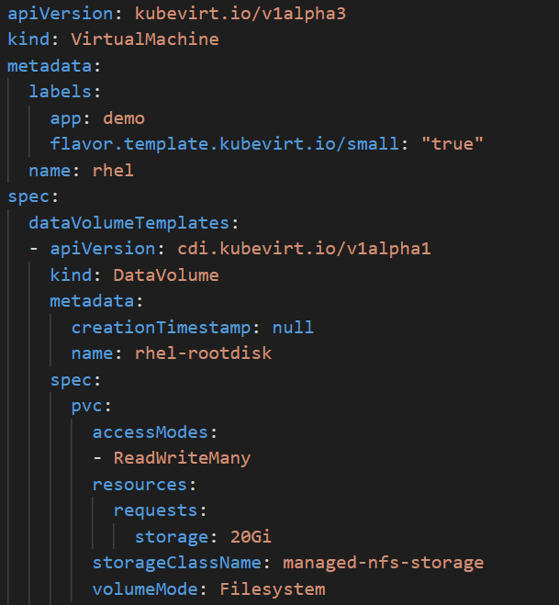
Virtualization native to Kubernetes
New CustomResourceDefinitions (CRDs) for native VM integration, for example:
VirtualMachine
VirtualMachineInstance
VirtualMachineInstanceMigration
DataVolume
Operators are a Kubernetes-native way to introduce new capabilities

Slide 60
Containerizing KVM
2020 RED HAT TECH READY
RED HAT TECH READY 2020
CONFIDENTIAL - INTERNAL AND PARTNER UNDER NDA USE ONLY
Same trusted, mature KVM-based stack, wrapped in modern management and automation
Red Hat Virtualization
OpenShift Virtualization
Red Hat OpenStack Platform
RHV-M Console / CLI
OpenShift Console / CLI
OpenStack Horizon / CLI
RHV Host
RHEL CoreOS Host
OSP Compute
vdsm
kubelet
nova-compute
SVirt Security
KubeVirt Container
SVirt Security
libvirt
libvirt
libvirt
QEMU / KVM
QEMU / KVM
QEMU / KVM
VM
VM
VM

Slide 61
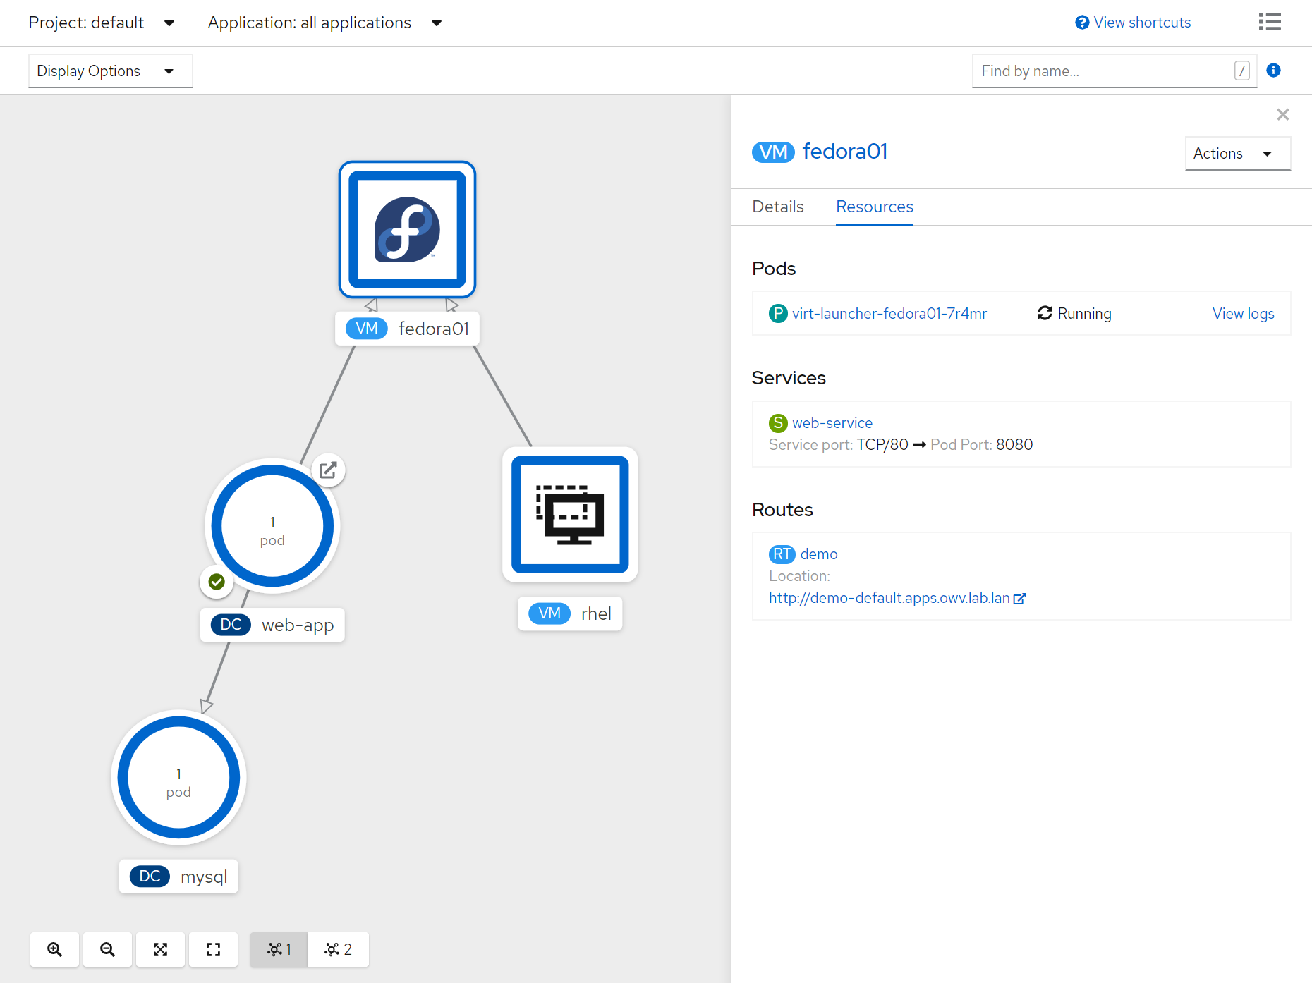
Using VMs and containers together
Virtual Machines connected to pod networks are accessible using standard Kubernetes methods:
Service
Route
Ingress
Network policies apply to VM pods the same as application pods
VM-to-pod, and vice-versa, communication happens over SDN or ingress depending on network connectivity

Slide 62
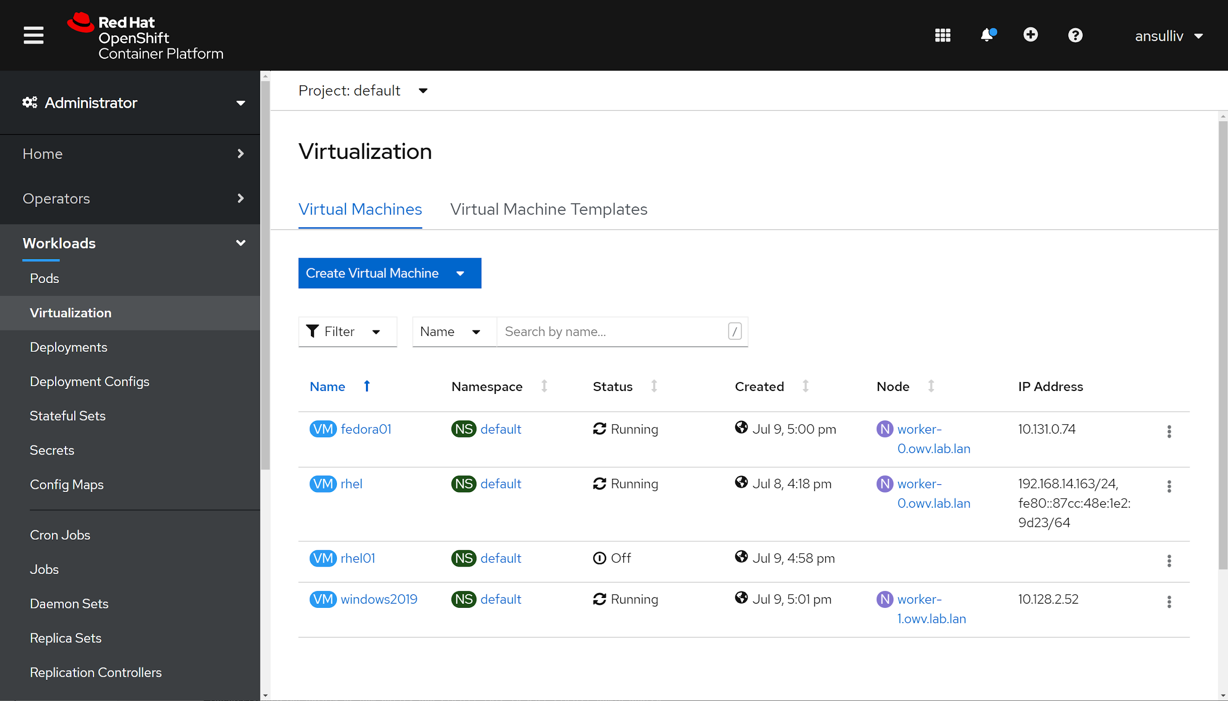
Virtual Machine Management
Create, modify, and destroy virtual machines, and their resources, using the OpenShift web interface or CLI
Use the virtctl command to simplify virtual machine interaction from the CLI

Slide 63
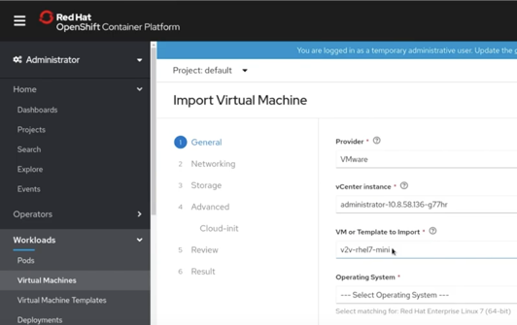
Modernize existing virtual machine workloads
Supports VMware & Red Hat Virtualization (now), Red Hat OpenStack Platform (later)
Run Red Hat Migration Analytics from cloud.redhat.com to select best candidates for import to OpenShift
For single VMs, run the Import Virtual Machine workflow from OpenShift
For multiple VMs, leverage the Red Hat Migration tool for batch import (longer term)
Import as a single VM or create a template for multiple ones

Slide 64
OpenShift Security

Slide 65



OPENSHIFT SECURITY | Comprehensive features
Container Content
CI/CD Pipeline
CONTROL Application Security
Container Registry
Deployment Policies
Container Platform
Container Host Multi-tenancy
DEFEND Infrastructure
Network Isolation
Storage
Audit & Logging
API Management
EXTEND
Security Ecosystem

Slide 66
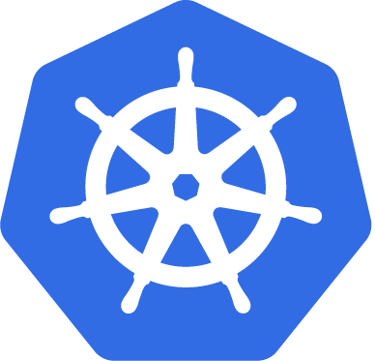

Extended Depth of Protection
OPENSHIFT SECURITY | Comprehensive features
Feature Transfer (upstream)
Security Context Constraint (SCC)
Pod Security Preset (PSP)
Feature Development (joint)
Notes:
Security Context Constraints (SCCs) allow administrators to control permissions for pods. SCCs define a set of conditions that a pod must run with in order to be accepted into the system. Red Hat has contributed this feature to Kubernetes as Pod Security Policies (PSPs).
PSPs are not yet as mature as SCCs. We will enable customers to migrate from SCCs to PSPs as soon as we have feature parity. We are also working to ensure that SCCs support new settings available with PSPs. Additional information on these new settings is available in Kubernetes documentation.

Slide 67

Certificates and Certificate Management
OPENSHIFT SECURITY | Comprehensive features
OpenShift provides its own internal CA
Certificates are used to provide secure connections to
master (APIs) and nodes
Ingress controller and registry
etcd
Certificate rotation is automated
Optionally configure external endpoints to use custom certificates
✓
MASTER
✓
ETCD
✓
NODES
✓
INGRESS CONTROLLER
✓
CONSOLE
✓
REGISTRY
Notes:
For example: Requesting and Installing Let’s Encrypt Certificates for OpenShift 4

Slide 68
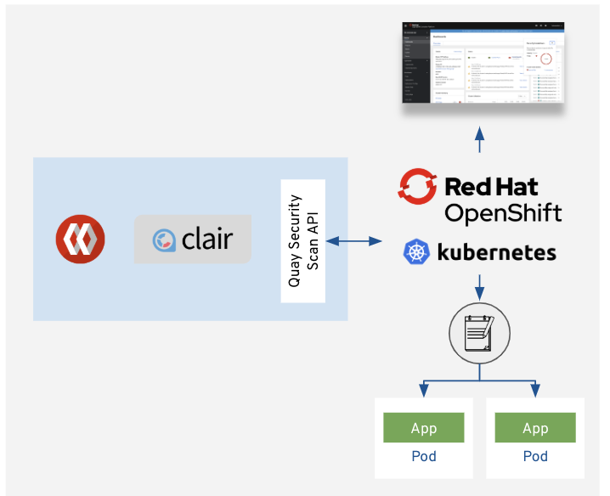
Container Security Operator (CSO) and Quay
What is it?
Container Security Operator (CSO) runs on OpenShift and watches pod objects
How does it work?
Why do you need it?
Easily visualize image security vulnerability data from Quay / Clair

Slide 69
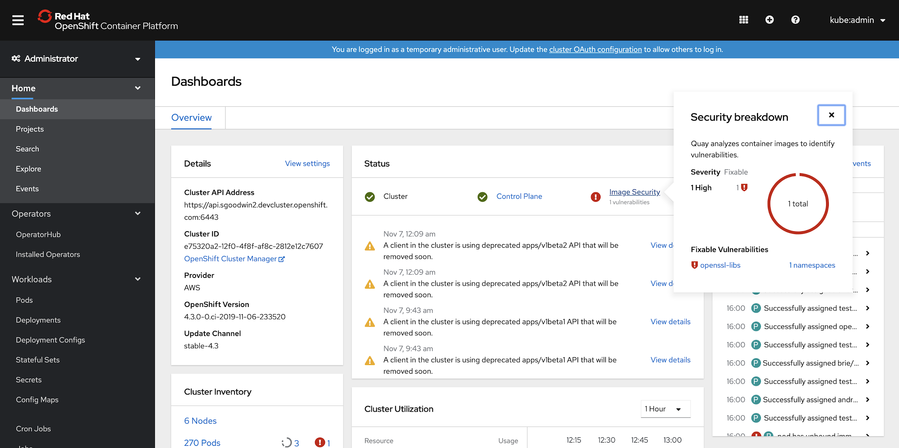
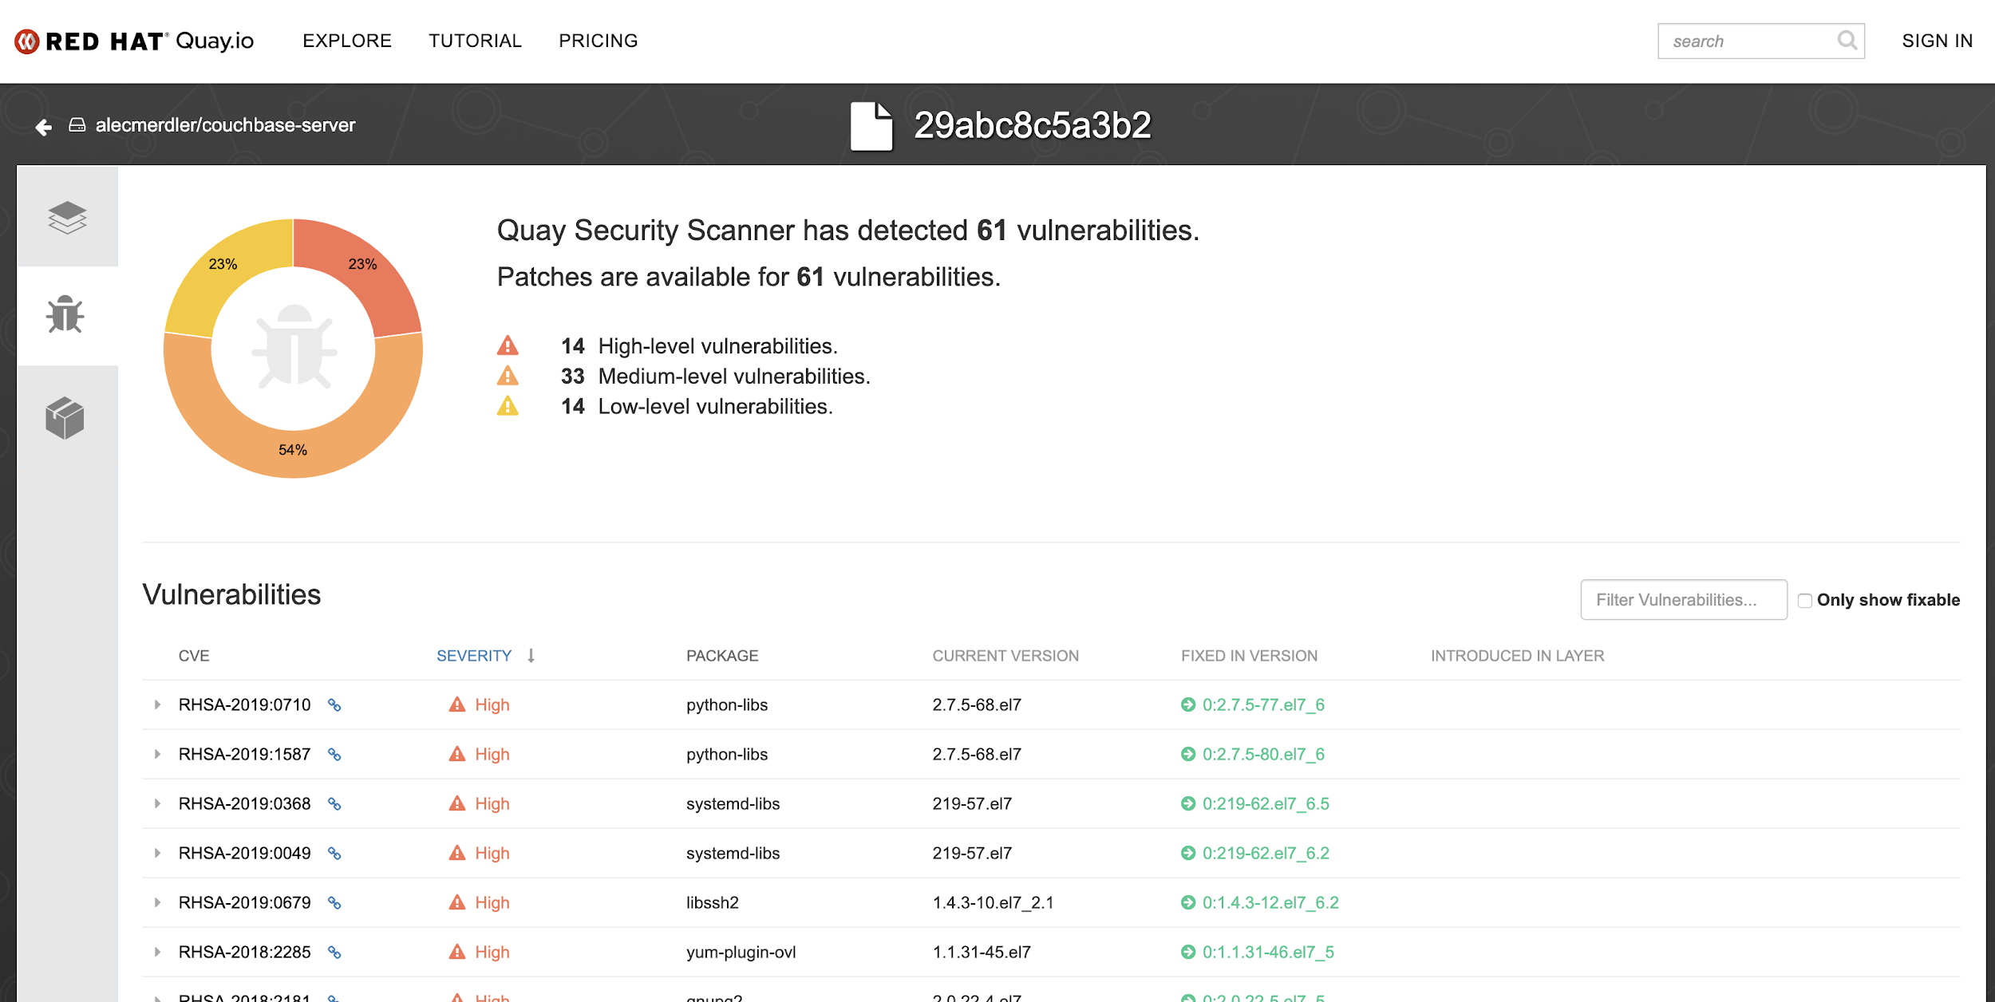
View Image Security Vulnerabilities in OpenShift
See all your Container Vulnerabilities right from the Console Dashboard
Link out to Red Hat Quay for more in depth information
The Quay Operator supports both On-premise and External Quay Registries
Currently uses Clair for Security Scan; Planning to expand to other Vendors( TwistLock, Aqua, e.g. )
Only works for images managed by Quay
Notes:
This uses the Container Storage Operator(CSO), this will allow use to surface vulnerability data on the cluster overview dashboard: Note this is only for containers being managed by Quay

Slide 70
OpenShift Developer Services

Slide 71











Openshift Service Mesh
Connect services securely with zero-trust network policies.
Automatically secure your services with managed authentication, authorization and encryption.
Control traffic to safely manage deployments, A/B testing, chaos engineering and more.
See what’s happening with out of the box distributed tracing, metrics and logging.
Manage OpenShift Service Mesh with the Kiali web console.
Services
F
Envoy
Envoy
Envoy
OpenShift Service Mesh
Istio
Kiali
Jaeger
OPENSHIFT
Red Hat Enterprise Linux CoreOS
Physical
Virtual
Private cloud
Public cloud

Slide 72



Openshift Serverless
Generally Available
Event-driven serverless containers and functions
Deploy and run serverless containers
Use any programming language or runtime
Modernize existing applications to run serverless
Powered by a rich ecosystem of event sources
Manage serverless apps natively in Kubernetes
Based on open source project Knative
Run anywhere OpenShift runs
Applications
Events
F
OpenShift Serverless
SERVING
FUNCTIONS*
EVENTING
OPENSHIFT
Red Hat Enterprise Linux CoreOS
Physical
Virtual
Private cloud
Public cloud
* Functions are currently a work in progress initiative
Notes:
So far we covered the serverless market. But we have baked serverless capabilities into the platform with OpenShift Serverless enabling almost any containerized application to run Serverless. That means you can choose any programming language of choice and enable auto-scaling behavior, scaling up to meet demand and down even to zero.
Beyond auto-scaling for HTTP requests, you can trigger those serverless containers from a variety of event sources and receive events such as Kafka messages, file upload to Storage, Timers for recurring jobs and 100+ event sources like Salesforce, Service Now, E-mail, etc… powered by Camel-K .
OpenShift Serverless is based on the open source project Knative, one of the fastest growing Serverless projects in the market. This ensures that you don't suffer with lock-in concerns and can still get the innovation from a growing open source community.
We are very happy to announce that OpenShift Serverless is now GA, which means you can take it to production and run anywhere OpenShift runs, delivering a hybrid serverless experience with portability and flexibility.

Slide 73

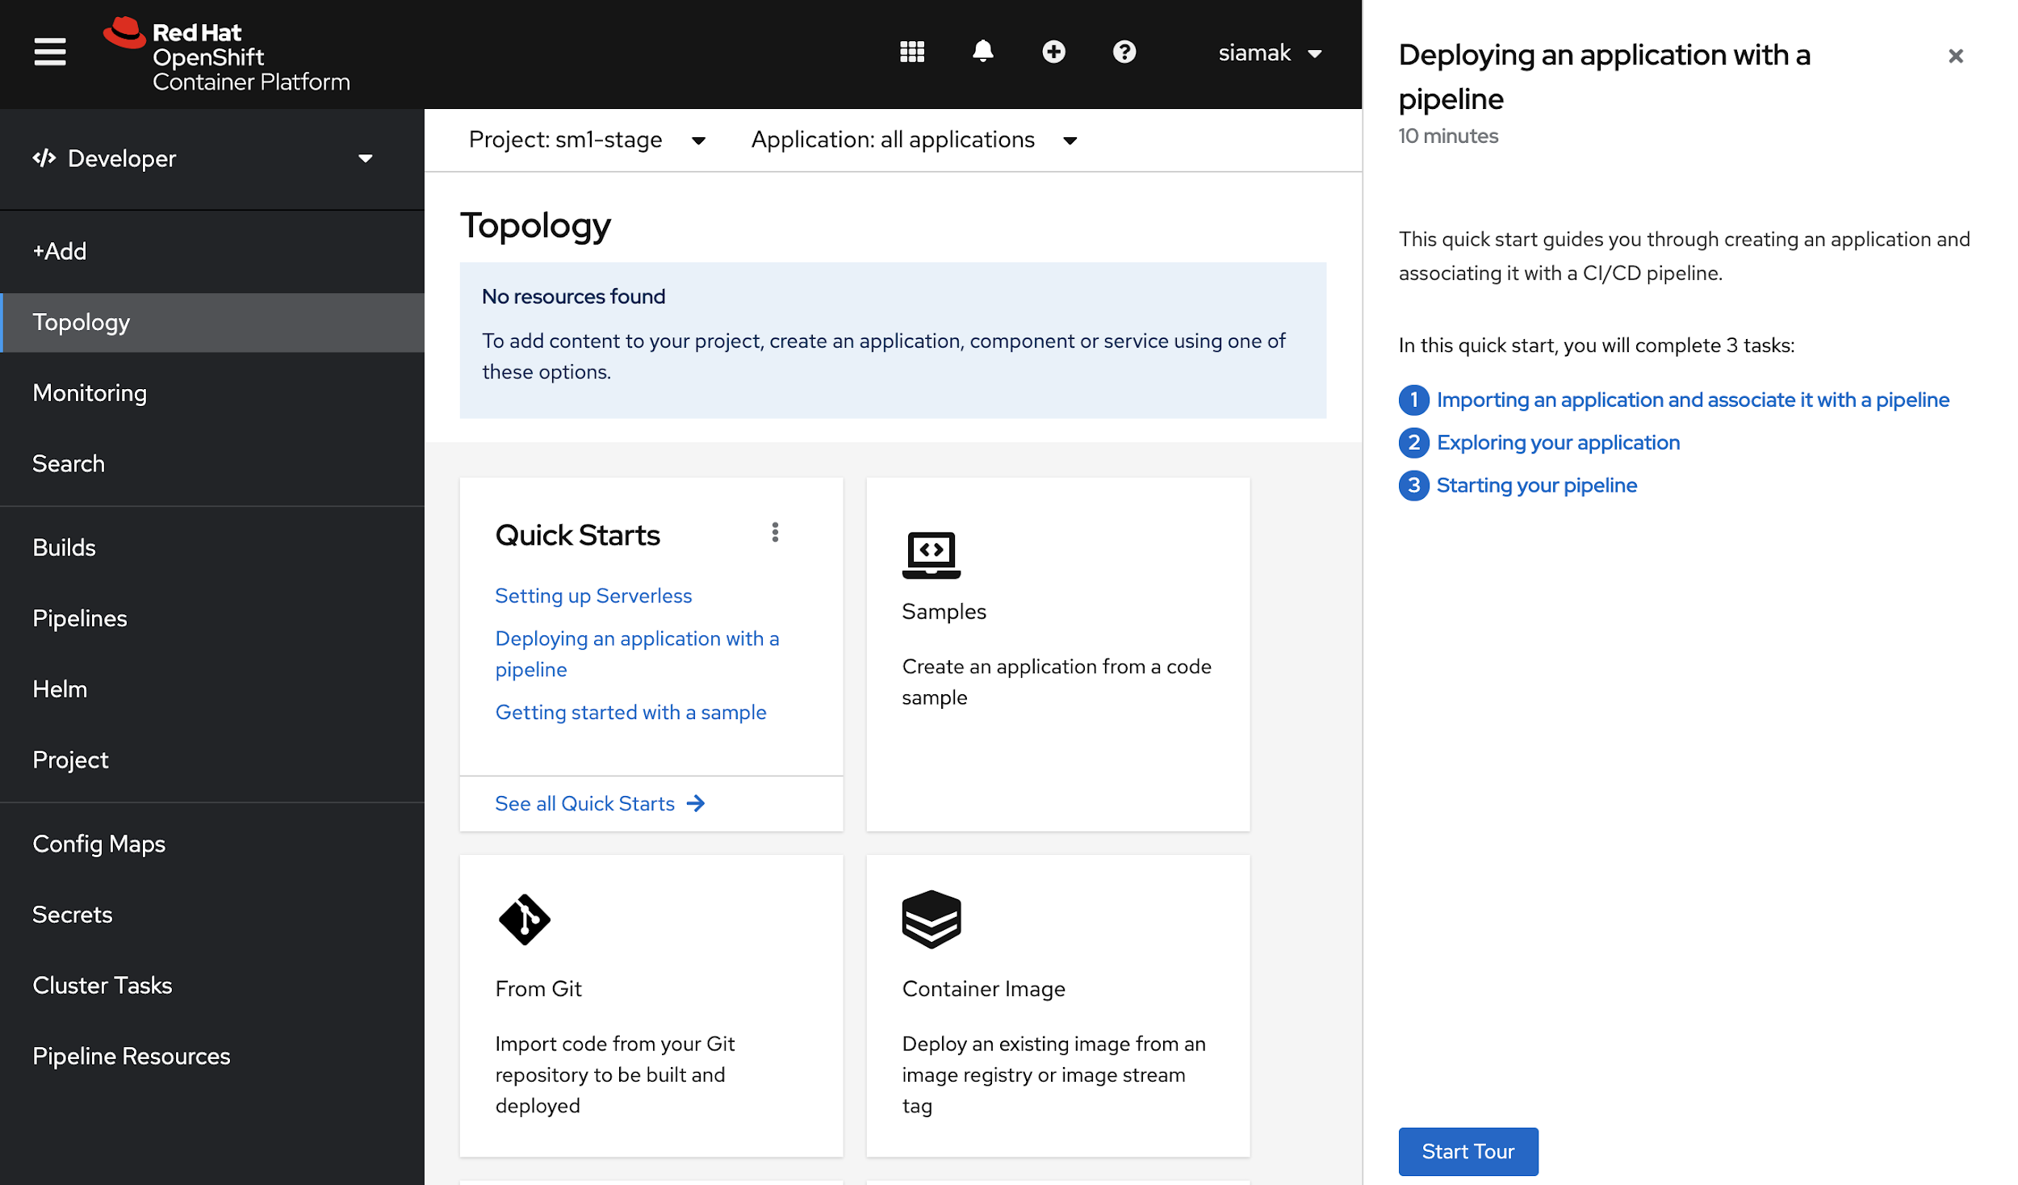
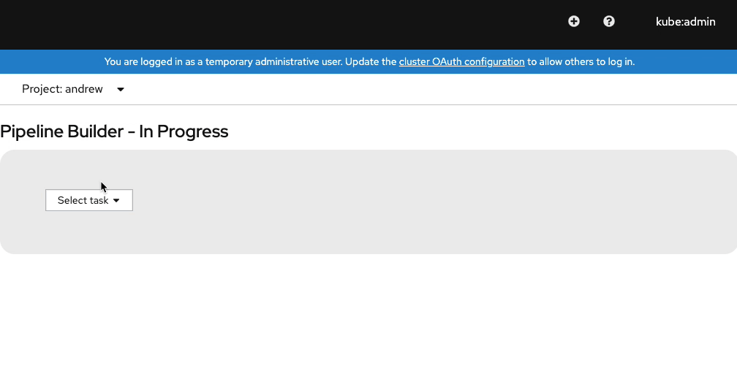
Cloud-native CI/CD with OpenShift Pipelines
Tech Preview
Pipeline templates for serverless when importing application (+Add)
Pipeline templates use workspaces instead of PipelineResources
Default workspace per PipelineRun or globally
Expanded Task library
Helm tasks
Skopeo tasks
Trigger Jenkins jobs from Tekton
Support for disconnected clusters
Pipeline metrics in cluster monitoring
Pipeline Quick Start tours in Dev Console
Enhancements in Tekton CLI: workspaces, results, ...
Product Manager: Siamak Sadeghianfar
* Available through the OpenShift Pipelines operator “preview” channel
Notes:
Speaker: Siamak Sadeghianfar Video: https://youtu.be/igwFpZOUTnw

Slide 74

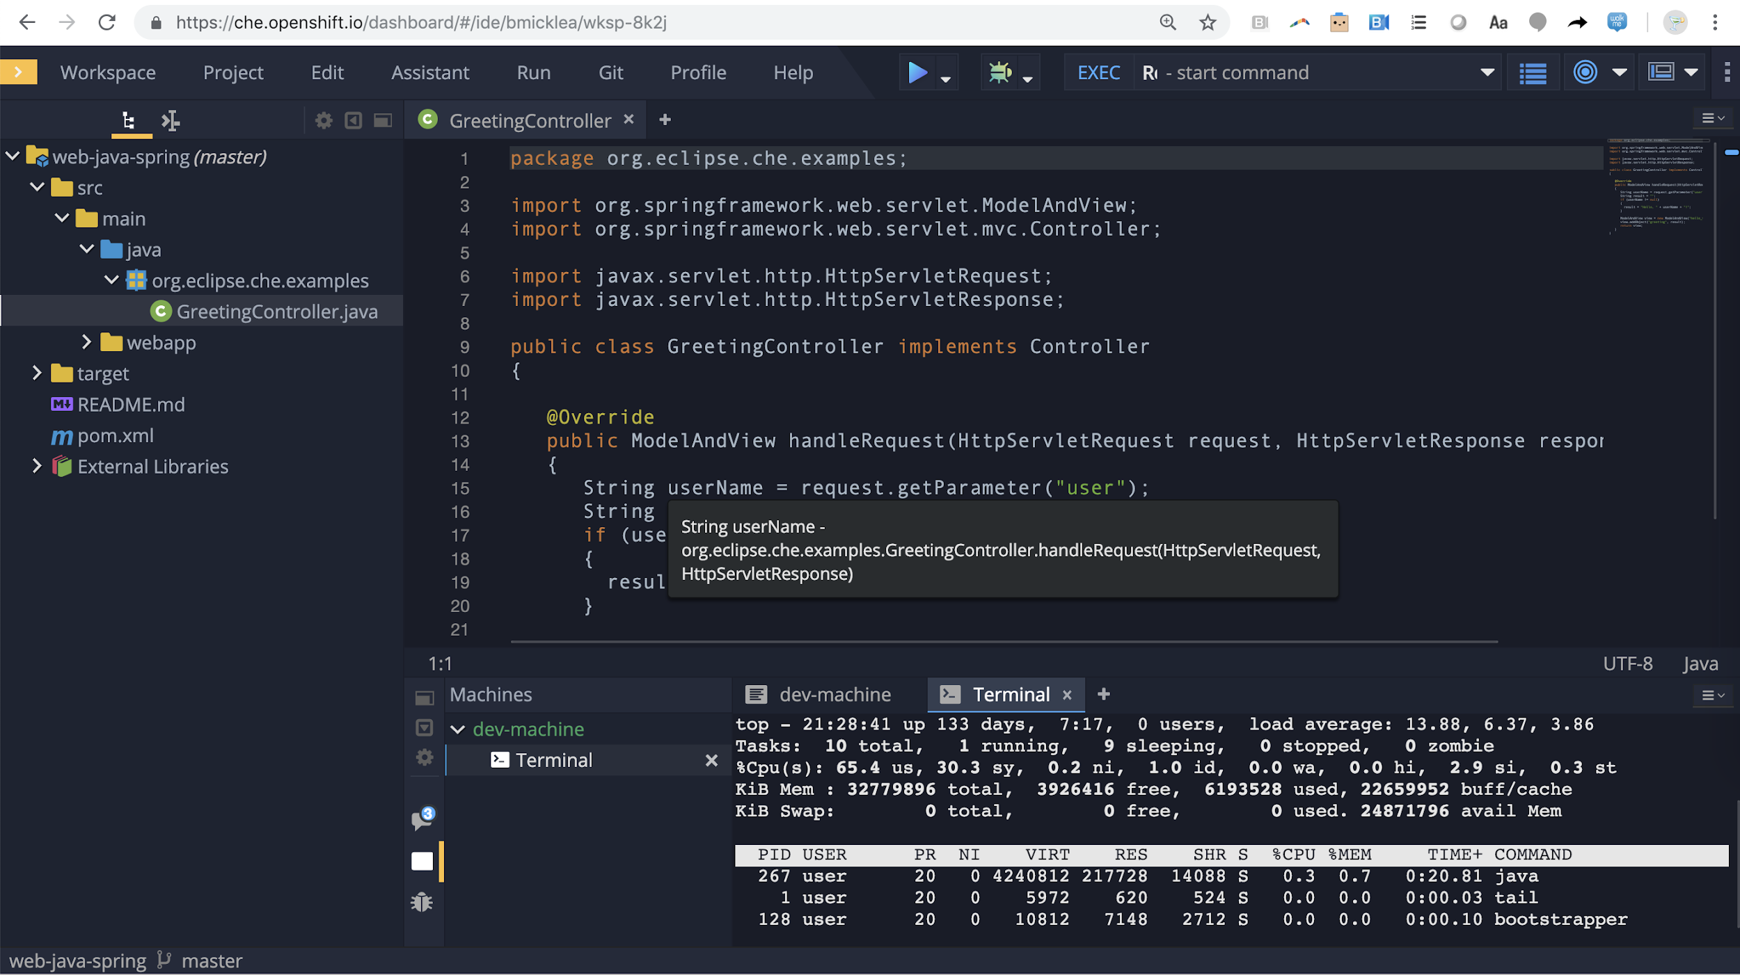
CodeReady Workspaces
Web-based Eclipse Che IDE
Developer workspaces in pods
Bundled development stacks
Available in OperatorHub

Slide 75


Podman and Buildah
OpenShift Architecture
A docker-compatible CLI for containers
Secure & flexible OCI container builds
Remote management API via Varlink
Image/container tagging
Advanced namespace isolation
Integrated into OCP build pods
Performance improvements for knative enablement
Image signing improvements

Slide 76


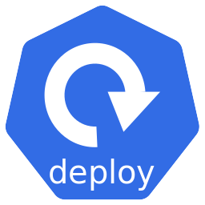

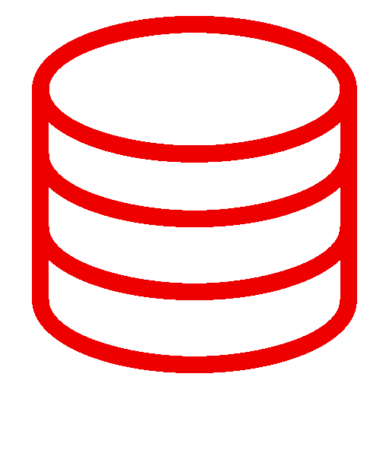

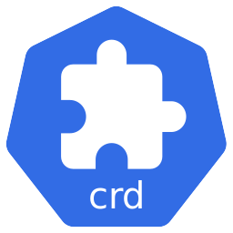
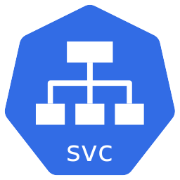


Helm 3 on OpenShift
Helm is a package manager for Kubernetes applications and helps to define, install and update apps
Helm Chart (templates)
OPENSHIFT
NAMESPACE
Helm CLI
Releases
Image
Repository
Values (configs)
Product Manager: Siamak Sadeghianfar
Notes:
Speaker: Siamak Sadeghianfar
A Helm Chart is an application package that contains templates for a set of resources (e.g. deployment, service, etc) that are necessary to run the application. A template uses variables that are substituted with values when the manifest is created. The chart includes a values file that describes how to configure the resources.
When a Chart gets installed, the values in the values file is replaced in the Chart templates and a Release is produced which is an instance of a chart that is running in a Kubernetes cluster. You can install the same chart multiple times to create many releases.
Helm 3 does not have any serverside component (no Tiller)
Helm 3 is in Tech Preview on OCP 4.3

Slide 77
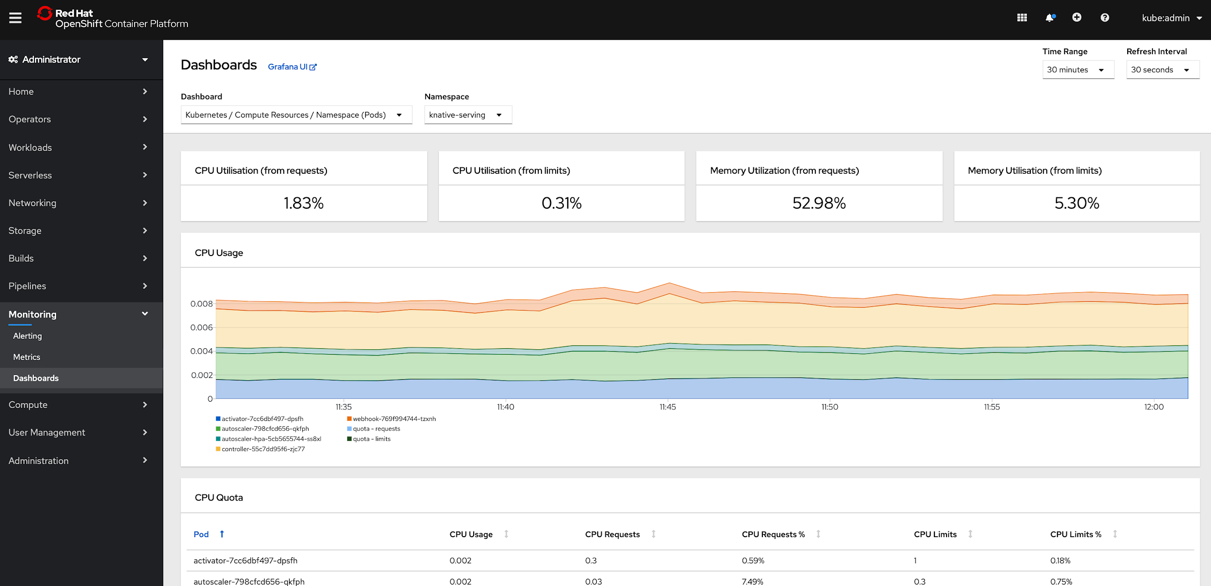
Metrics Dashboard
At-a-glance views for your mission critical OpenShift components right from the OpenShift Console.
Offers a single, centralized place for all OpenShift components to provide insights into critical KPIs back to you.
Switch between dashboards, representing different parts of your cluster.
Filter by different criterias defined by a dashboards and different time ranges.

Slide 78
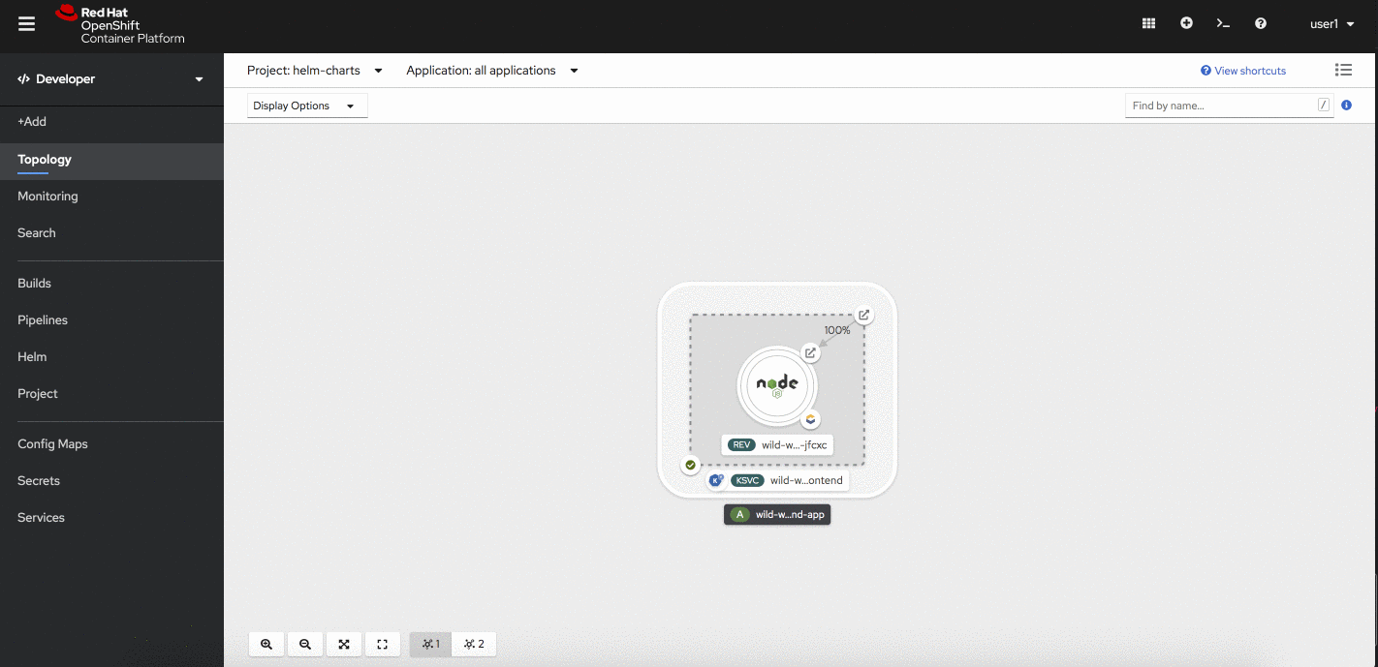
Easy access to Web Terminal
Tech Preview
Use CLIs direct from web console, and fully authenticated when you need them.
oc, odo, kubectl
Terminal can be minimized and opened in new tab
History is not retained between sessions
Not supported for cluster admins
Operator enabled
Available in first z stream
Product Manager: Serena Nichols
Notes:
Speaker: Serena Nichols

Slide 79
OpenShift 4 Lifecycle
Supported paths for upgrades and migrations

Slide 80
Support Timelines
OPENSHIFT CONTAINER PLATFORM | Lifecycle
* Hypothetical timeline for discussion purposes
4.1
full support
Rolling 3 release support window
critical support
unsupported
4.2
4.3
New model
Release based, not date based. Rolling three release window for support.
The overall 4 series will be supported for at least three years
Minimum two years full support (likely more)
One year maintenance past the end of full support
EUS release planned
Supported for 14 months of critical bug and critical security fixes instead of the normal 5 months. If you stay on the EUS for its entire life, you must use the application migration tooling to move to a new cluster

Slide 81
Upgrades vs. Migrations
OPENSHIFT CONTAINER PLATFORM | Lifecycle
* Hypothetical timeline for discussion purposes
4.1
full support
critical support
unsupported
4.2
OTA upgrade
4.3
Migration tool
OTA Upgrades
Works between two minor releases in a serial manner.
Happy path = migrate through each version
On a regular cadence, migrate to the next supported version.
Optional path = migration tooling
If you fall more than two releases behind, you must use the application migration tooling to move to a new cluster.
Current minor release
Full support for all bugs and security issues
1 month full support overlap with next release to aid migrations
Previous minor release
Fixes for critical bugs and security issues for 5 months
Notes:
Jumping from 4.1 to 4.2 to 4.3 can be done in-place, via over the air upgrade. This process should be one click and painless, even though you need to do execute more of them than you are used to.
If you can not (or will not) progress serially through minor versions, you must use the migration tool to “jump” a release.

Slide 82
Unlock the potential - get skilled
Skills Assessment for the customer
DO080
Deploying Containerized Applications Technical Overview
FREE On-line Prep Module
DO180
Introduction to Containers, Kubernetes, and Red Hat OpenShift
Ops/Administrator
path
Developer Path
DO280
Red Hat OpenShift Administration I
DO288
Red Hat OpenShift Development I: Containerizing Applications
EX280
Red Hat Certified Specialist in OpenShift Administration
EX288
Red Hat Certified Specialist in OpenShift Application Development
DO380
Red Hat OpenShift Administration II: High Availability
DO292
Red Hat OpenShift Development II: Creating Microservices with RHOAR
Notes:
Talking points:
Set with appropriate context from account
Practices like Agile and DevOps, infrastructures like public and private clouds all aim to make IT more responsive to changes in the needs of the business and focusing on services being delivered
Traditional IT operations focused more on separate duties and uptime over resilience and recovery
Changes are happening at a faster rate, both from external competitive pressure and from new IT practices
Alignment to story:
Customer priority is business agility which requires a shift to service delivery ready infrastructures and broader view that provides room for innovation while preserving today’s requirements.

Slide 83








RED HAT LEARNING SUBSCRIPTION
BASIC, STANDARD & DEVELOPER
 | Online Red Hat courses | Hands-on labs | Instructor videos | Video courses | Expert seminars | Instructor office hours | Learning paths | Certification exams
BASIC | X | X | X | X
DEVELOPER | X | X | X | X |  |  |  | X
STANDARD | X | X | X | X | X | X | X | X
Simple, flexible, on-demand training
- Annual subscription offering, no prerequisite required
- On-demand access, 24 hours per day, 7 days per week, worldwide
- Includes Red Hat online and video Training courses and hands-on labs
- Interactive learning interface allows users and managers to track progress
Notes:
Talking points:
Set with appropriate context from account
Practices like Agile and DevOps, infrastructures like public and private clouds all aim to make IT more responsive to changes in the needs of the business and focusing on services being delivered
Traditional IT operations focused more on separate duties and uptime over resilience and recovery
Changes are happening at a faster rate, both from external competitive pressure and from new IT practices
Alignment to story:
Customer priority is business agility which requires a shift to service delivery ready infrastructures and broader view that provides room for innovation while preserving today’s requirements.

Slide 84
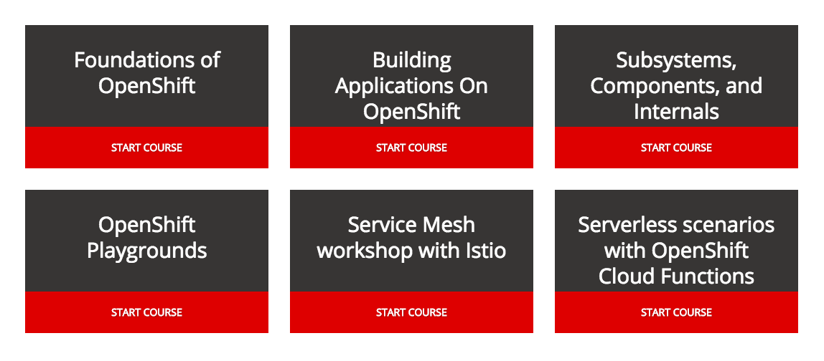
LEARN.OPENSHIFT.COM
Interactive Learning Scenarios provide you with a pre-configured OpenShift instance, accessible from your browser without any downloads or configuration.

Slide 85
Demo

Slide 86
Thank you
Red Hat is the world’s leading provider of enterprise open source software solutions. Award-winning support, training, and consulting services make Red Hat a trusted adviser to the Fortune 500.

